Slide 1
Update on District Projects
Trevor Ahring, Civil Engineer

Slide 2
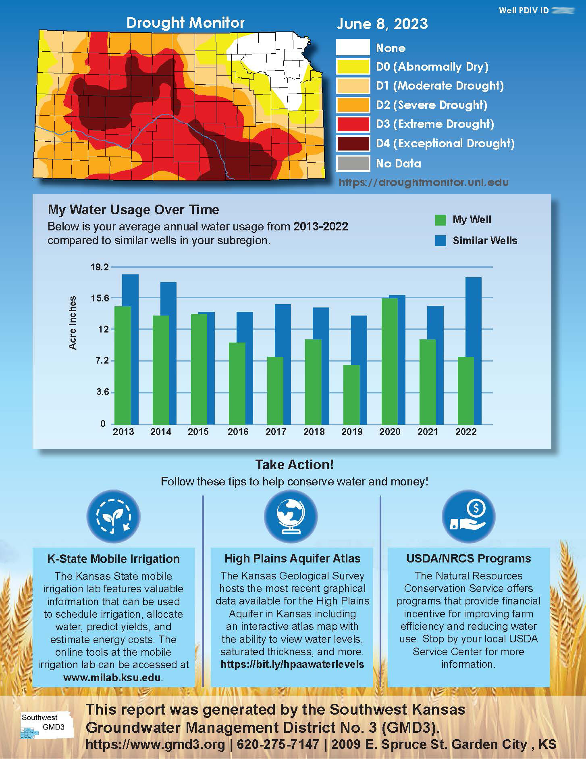

Slide 3
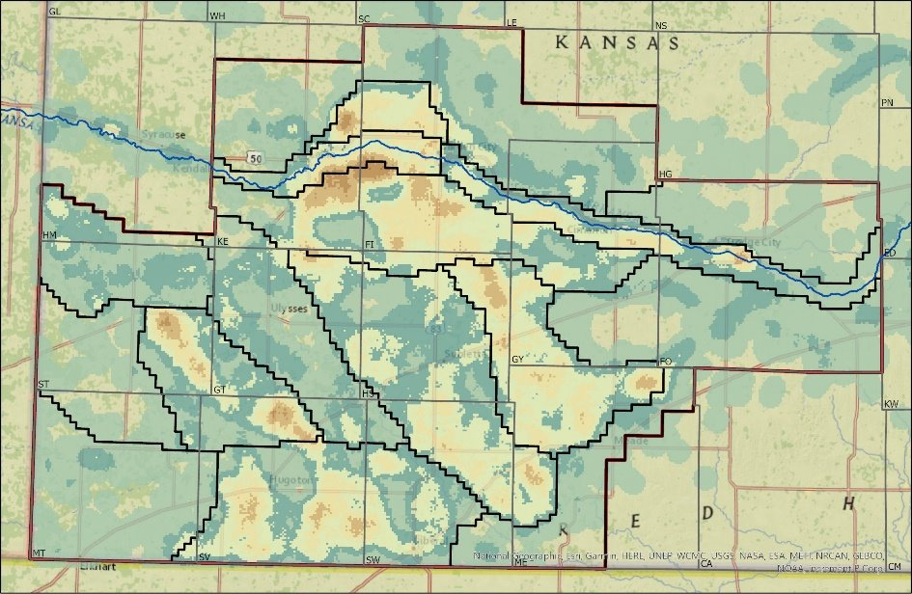
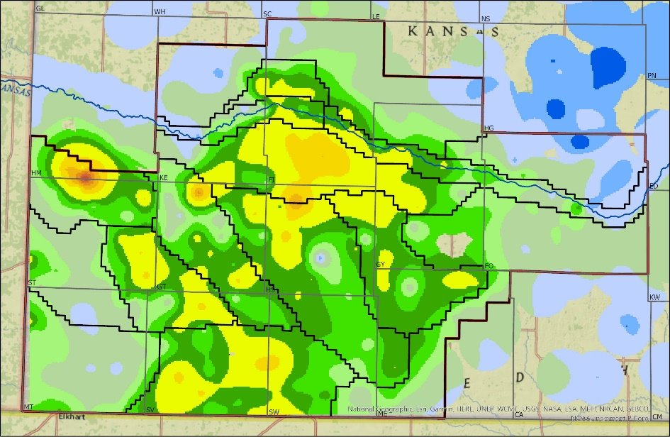
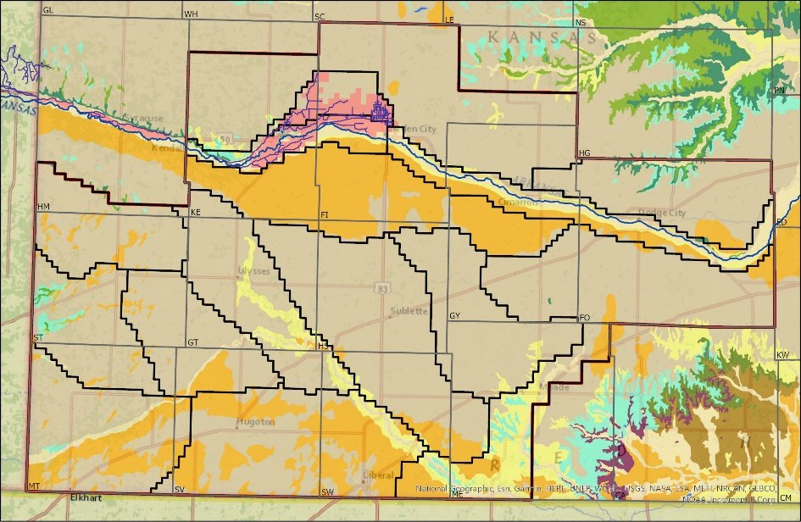
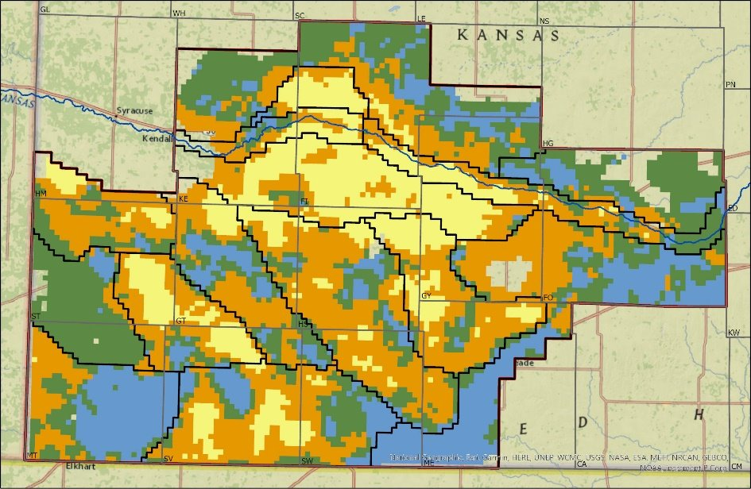
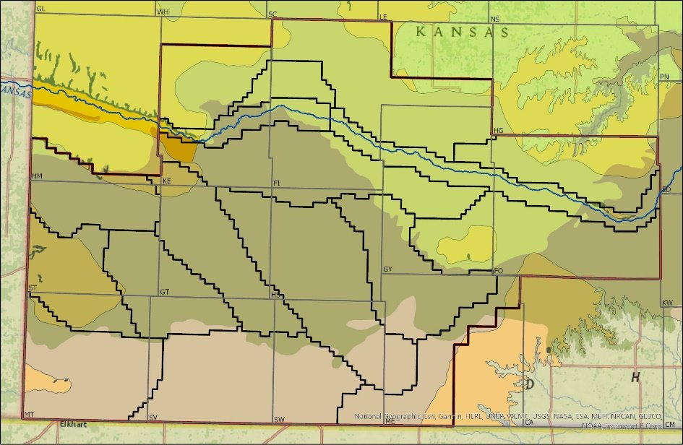
Aquifer Thickness
Use Density
Water Level Change
Geology/Ditch/IGUCA
Merged Rankings
HPA/Dakota Extents

Slide 4
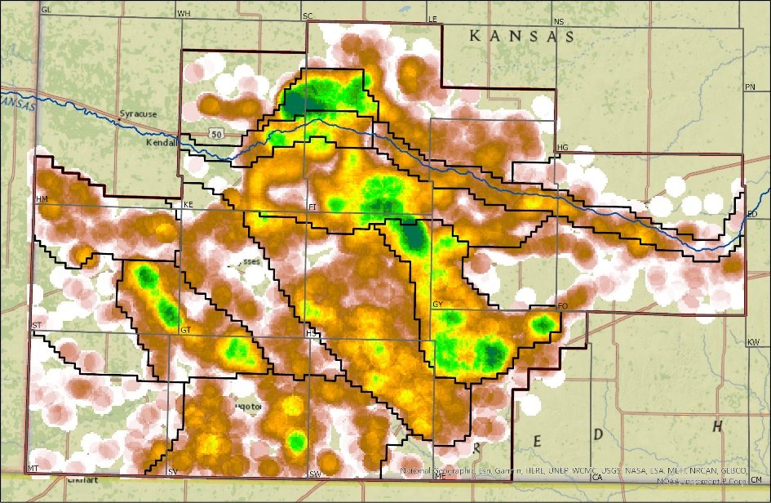
Aquifer Thickness
GMD3 Rate Data
Water Level Change
Geology/Ditch/IGUCA
Merged Rankings
HPA/Dakota Extents

Slide 5
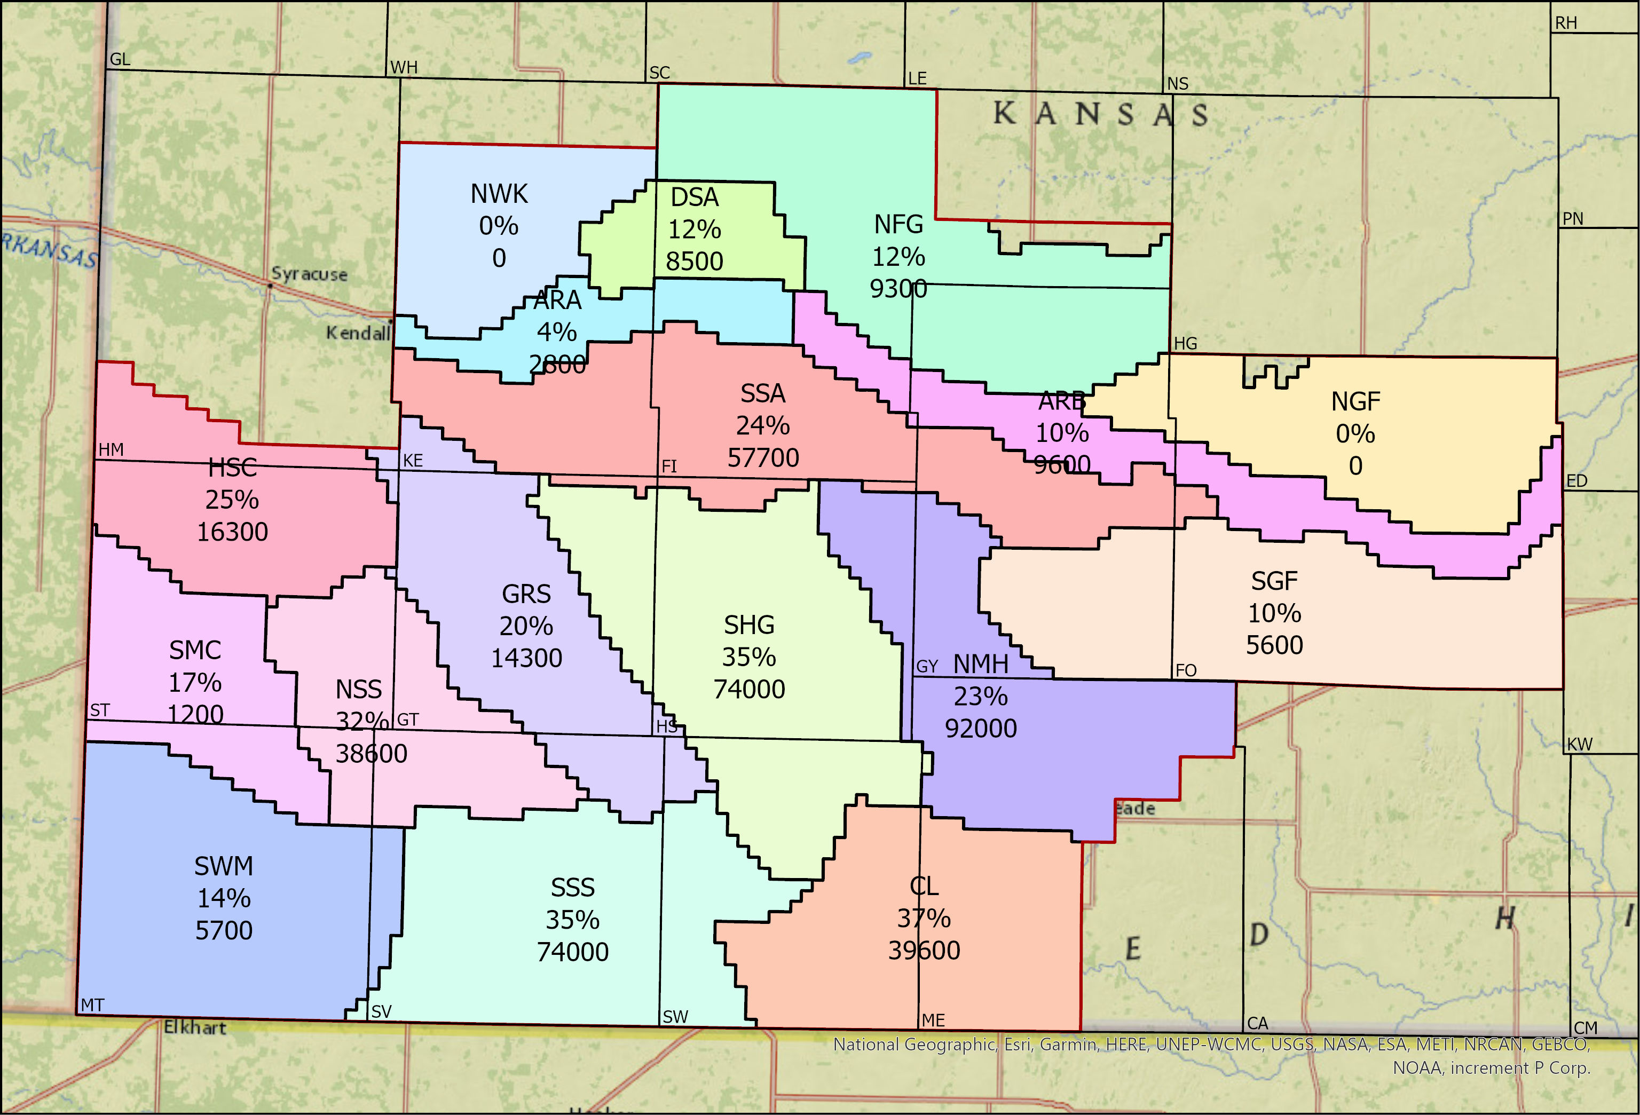

Slide 7
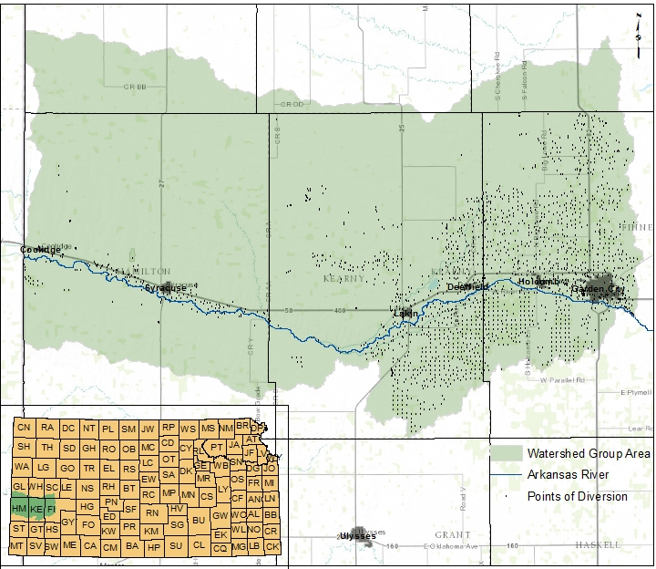
Upper Ark Watershed Group
Advisory committee started in June 2022.
Group meets monthly.
Mission, bylaws, and articles of incorporation were drafted.
Initial board was put in place July 2023.
Officially incorporated as a 501(c)(3) not-for-profit organization in December 2023.
Watershed restoration plan to be completed in June 2024.

Slide 8
Watershed Restoration Plan
Detail the water supply, local ecology, local population, recreational opportunity, and water demands. Identify all threats and resource concerns within the watershed.
Detail work underway to address concerns or otherwise improve the watershed.
Detail potential projects that can address or improve the watershed.
Identify any funding shortfalls.
Identify any opportunity for collaboration.
Identify opportunities to fund projects.

Slide 9
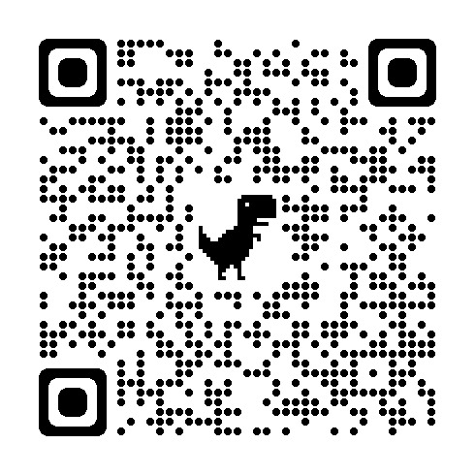

Slide 10
National Water Quality Initiative (NWQI)
KDHE successfully applied for an nwqi grant in 2023
Grant has been passed on to GMD3
Expect to have an official contract in April
GMD3 model will be used to run scenarios for various changes to pumping and land practices
Emphasis on the impact on water quality in the Arkansas River basin
A draft Basin plan will be completed by the end of 2024

Slide 11
NWQI (cont’d)
Four meetings for locals and stakeholders will be held to get feedback and finalize the plan
An implementation grant will be sought either in 2025 or 2026
Will provide targeted NRCS funds for implementation of practices and technologies for water users that will mitigate or improve water quality in the basin.

Slide 12
Smart plan
prioritize
Delineate priority areas
Priority areas must by submitted to the chief engineer by July 2024
Learn
Build from existing efforts like the GMD3 hydrologic model and i-care to develop decision support tools to predict the effect of various action plan scenarios on local regions
Statistical analysis of lost irrigated acreage
Forage production model

Slide 13
Statistical Analysis
GMD3 has lost about 6% of Irrigated acreage over the last 10 years
Amounts to about 85,000 acres
Water levels are declining and lost irrigated acreage is likely to accelerate
This study will allow GMD3 to evaluate proposed action plans by weighing immediate costs with long-term benefit of preserved agriculture

Slide 14
Forage Production Model
Six forage simulations will be simulated under 4 to 5 water input scenarios
Primary objective is to optimize forage systems for sustainable productivity under reduced irrigation inputs
Model will facilitate the design of water conservation that facilitates both stability of groundwater resources and economic productivity

Slide 15
Smart plan
Actuate
At least 12 meetings will be held throughout gmd3 to create action plans to address resource concerns within priority areas
Kansas State University will provide facilitation
Reasonable goals will be set to address water level declines and degraded water quality within each priority area
Could include any or all: LEMAS, WCAs, voluntary incentive-based conservation, compensation for specific land treatment practices
Action plans must be submitted to the chief engineer by July 2026

Slide 16
Smart plan
Navigate
All action plans will be set to run for a five-year period
Action plans that are meeting goals and adequately addressing resource concerns will be renewed
Action plans that are not meeting goals will be altered
Areas with action plans that are meeting goals but failing to address resource concerns will get new goals and action plans

Slide 17
Master Irrigator
Collaborating with Kansas GMDs and K-State to develop a statewide Master Irrigator program
Offer 5-7 courses per year
1 Course in each GMD with ability to expand based on demand
Program will be overseen by two advisory committees
One coordinator for western GMDs, one for eastern

Slide 18
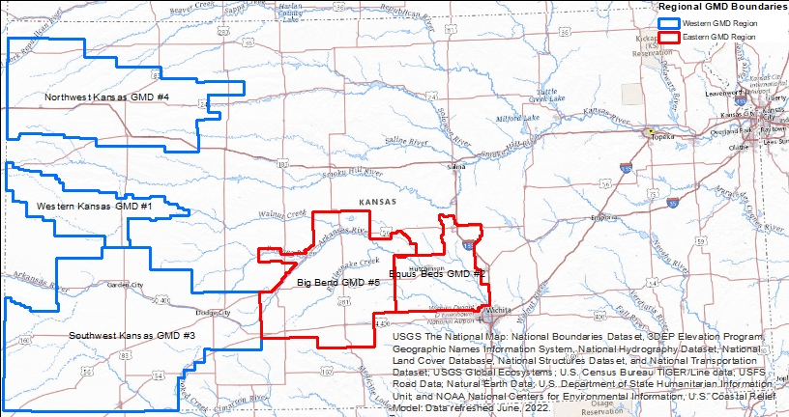

Slide 20
Master Irrigator Lite Event
Held in Ulysses in February 2024.
Agenda included:
Introduction to Master Irrigator Program
Understanding the Ogallala Aquifer and local water supply
Water rights 101
Farming with water allocations and using technology to make it work
Water technology discussion
Alternative crops
Taking advantage of federal and state funding
Introducing Testing Ag Performance Solutions (TAPS)

Slide 21
South Side Ditch Conversion to Pipe
Project will replace about 59,000 ft of open canal lateral with PVC pipe.
Estimated water savings of 543.4 AF

Slide 23
City of Deerfield
City has deteriorating water quality and will soon need to treat water or identify alternate source.
Project will evaluate four options:
Find and purchase a new well with better water quality
Install a new waterline from the City of Lakin to Deerfield to bring treated water
Install a central reverse osmosis water treatment plant to treat the water from the city’s existing wells
Conduct testing to determine to what extent uranium concentrations vary with depth and seal more shallow layers on the existing wells

Slide 24
Deliverables
Site-specific drawings including plan, elevation, and section drawings. Site preparation information such as erosion and sediment control plans, site grading, drainage, utilities, and demolition and removal including hazardous materials.
Details and specifications for fabrication, supply of material, construction, as applicable.
Construction cost estimate and schedule.

Slide 25
Questions?

