Slide 1
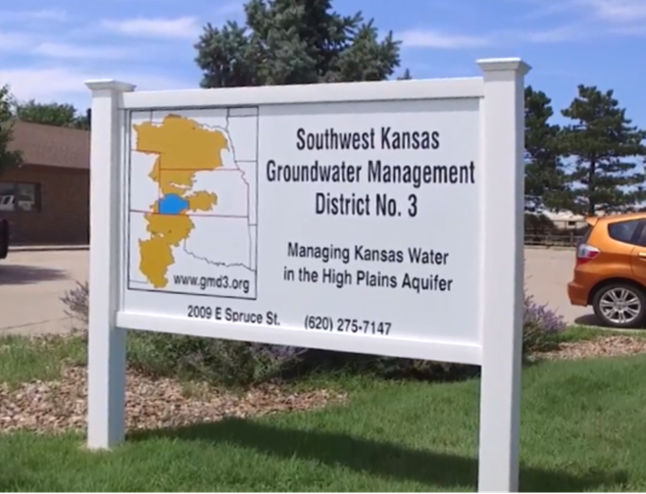
Southwest Kansas GMD3 Activities and Finances
49th Annual Meeting, Seward County Activities Ctr.
Mark Rude, Executive Director, GMD3

Slide 2


Information update, more later in the meeting
Your Board and staff
Management Program
Annual Report
Aquifer use and irrigated acres are dropping
Your water supply management
Priority area updates and action plans are coming
Learn and Manage your use and supply condition
Water Conservation activities and tools

Slide 3
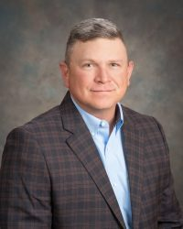
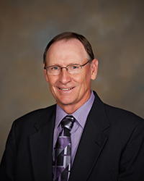
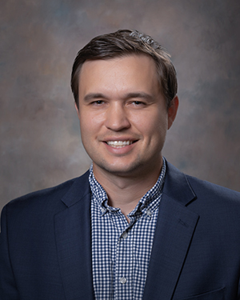
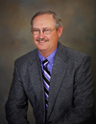
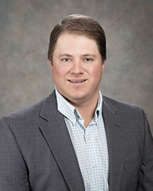
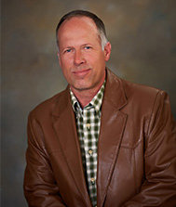
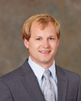
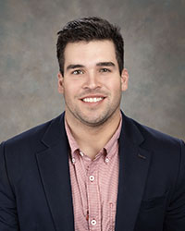
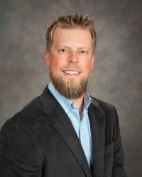
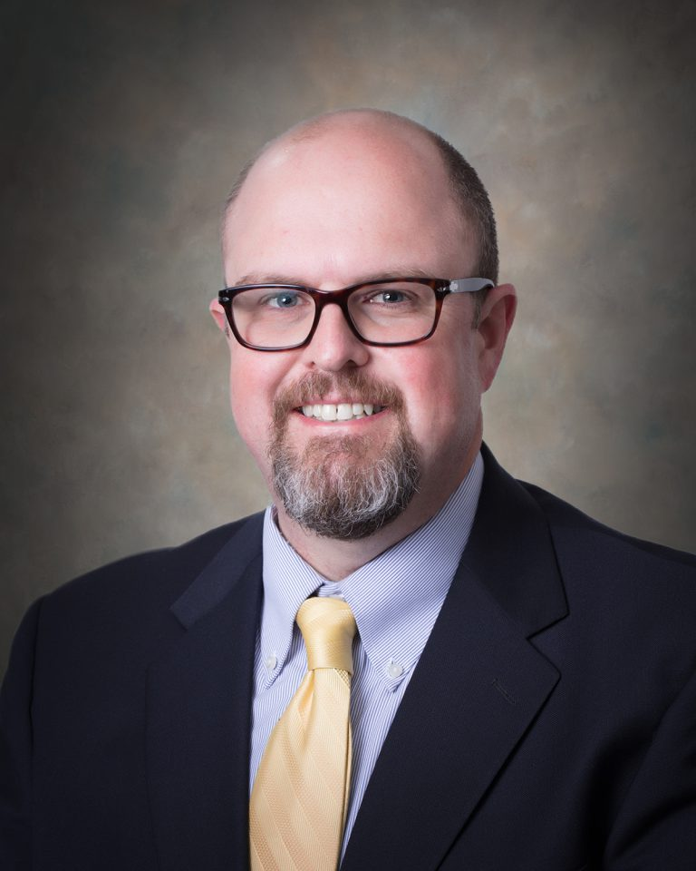
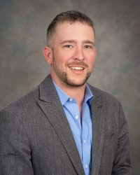
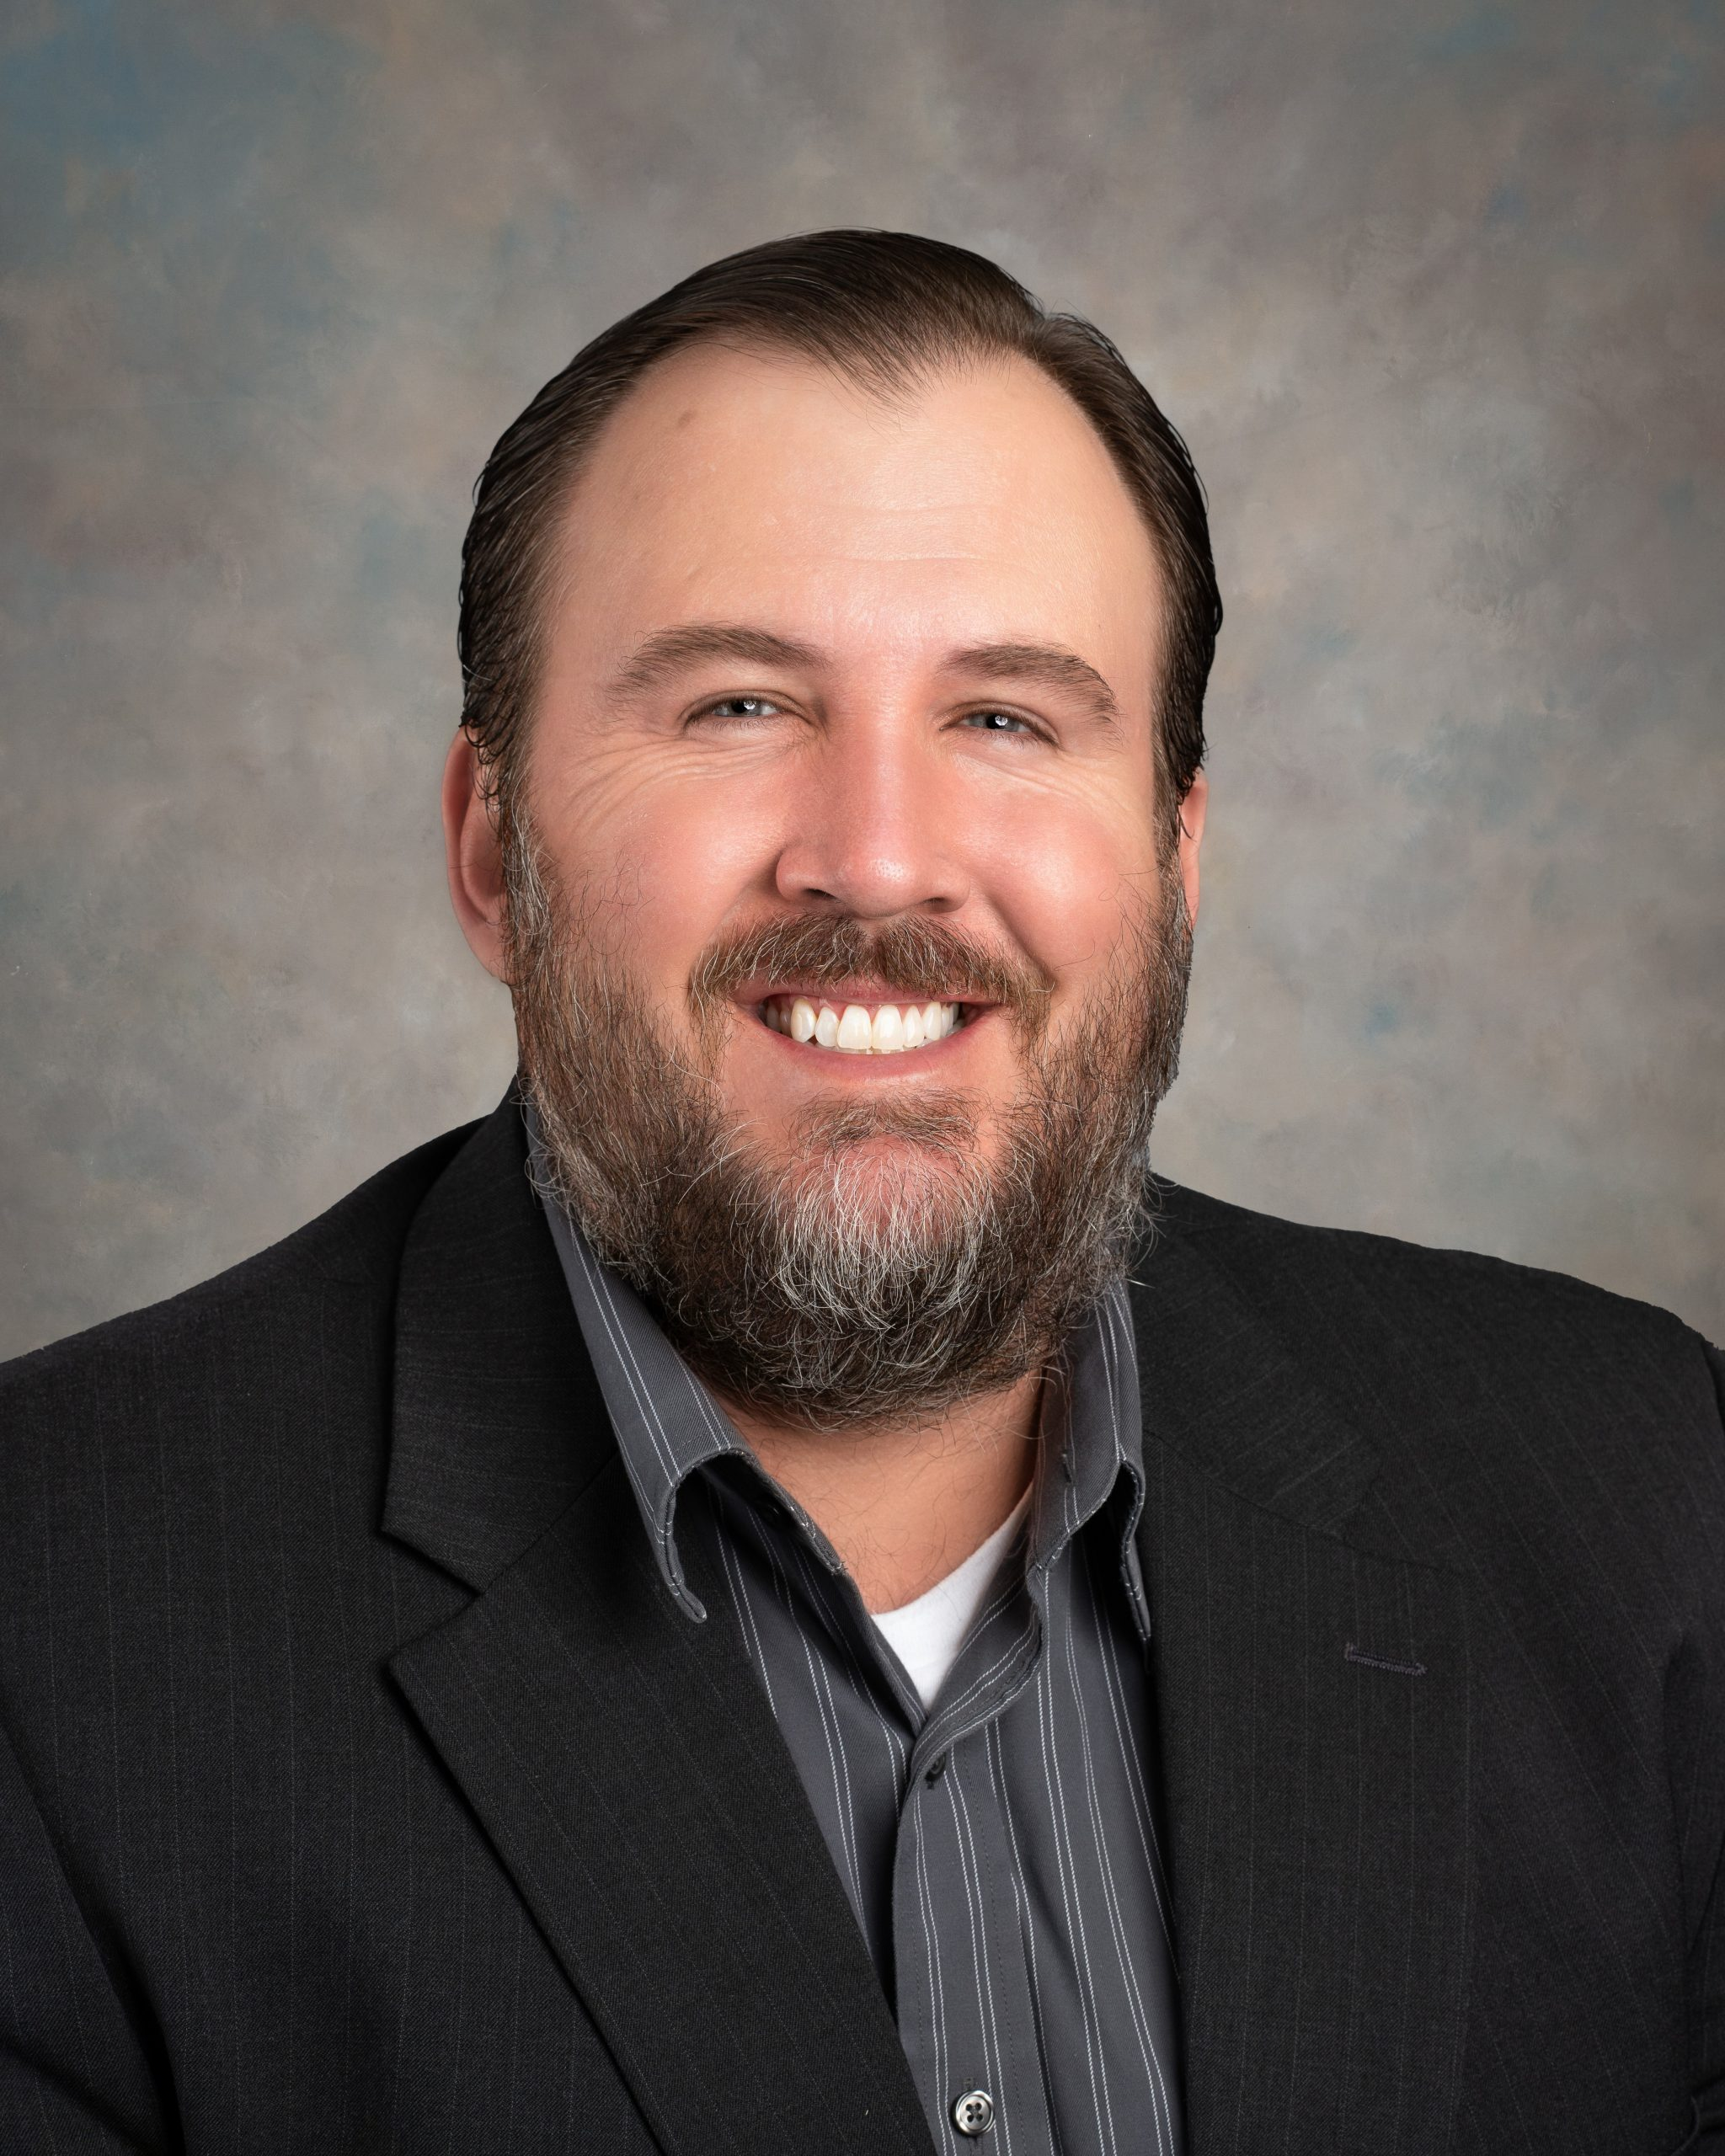
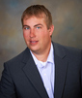
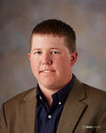
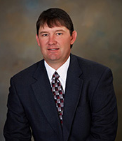

SW Kansas GMD3 Board of Directors

Slide 4
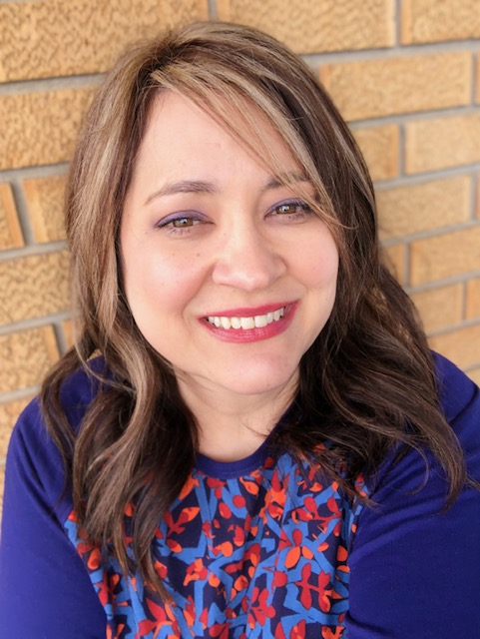
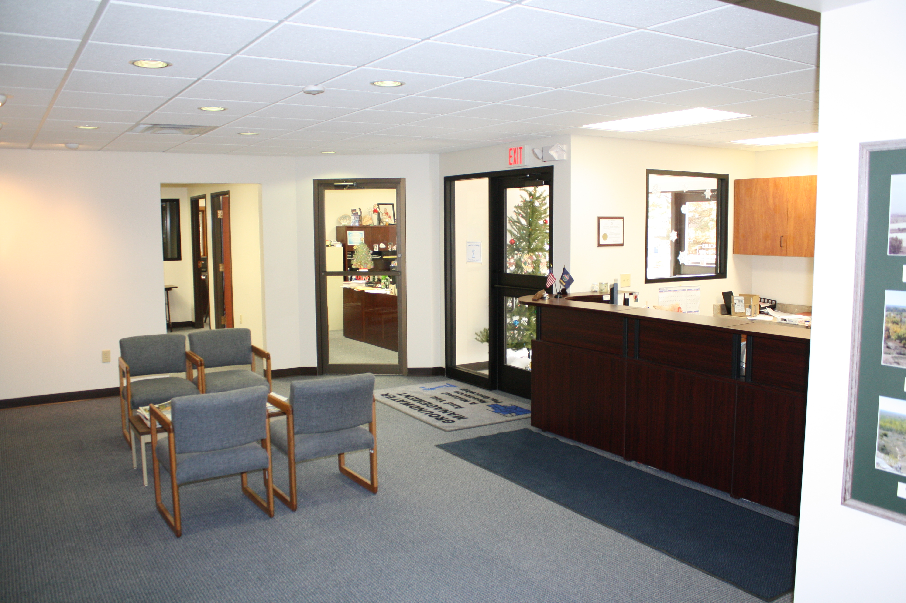

GMD3 Staff
12 years
Brandi Sneath, 9 years
Office Administration
  Receives your call
  Office and member support
  Ledger and records
  Communications
  Web master
  Perfect Audit Co-Manager

Slide 5
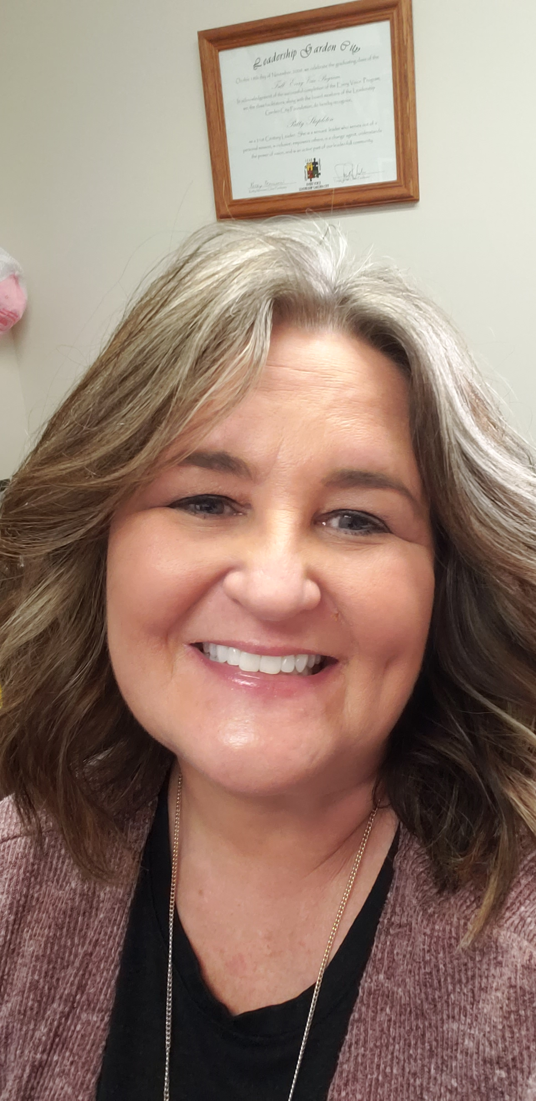
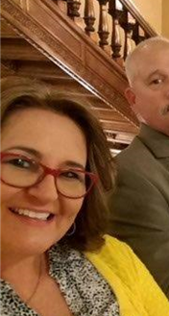
GMD3 Staff
Patty Stapleton, 17 yrs.
Office & Event manager
  Office Operations
  Board Clerk
  Special funds and events
  Watershed Group
  Assessments
  Banking and Insurance
  Communications
  Perfect Audit Co-Manager

Slide 6
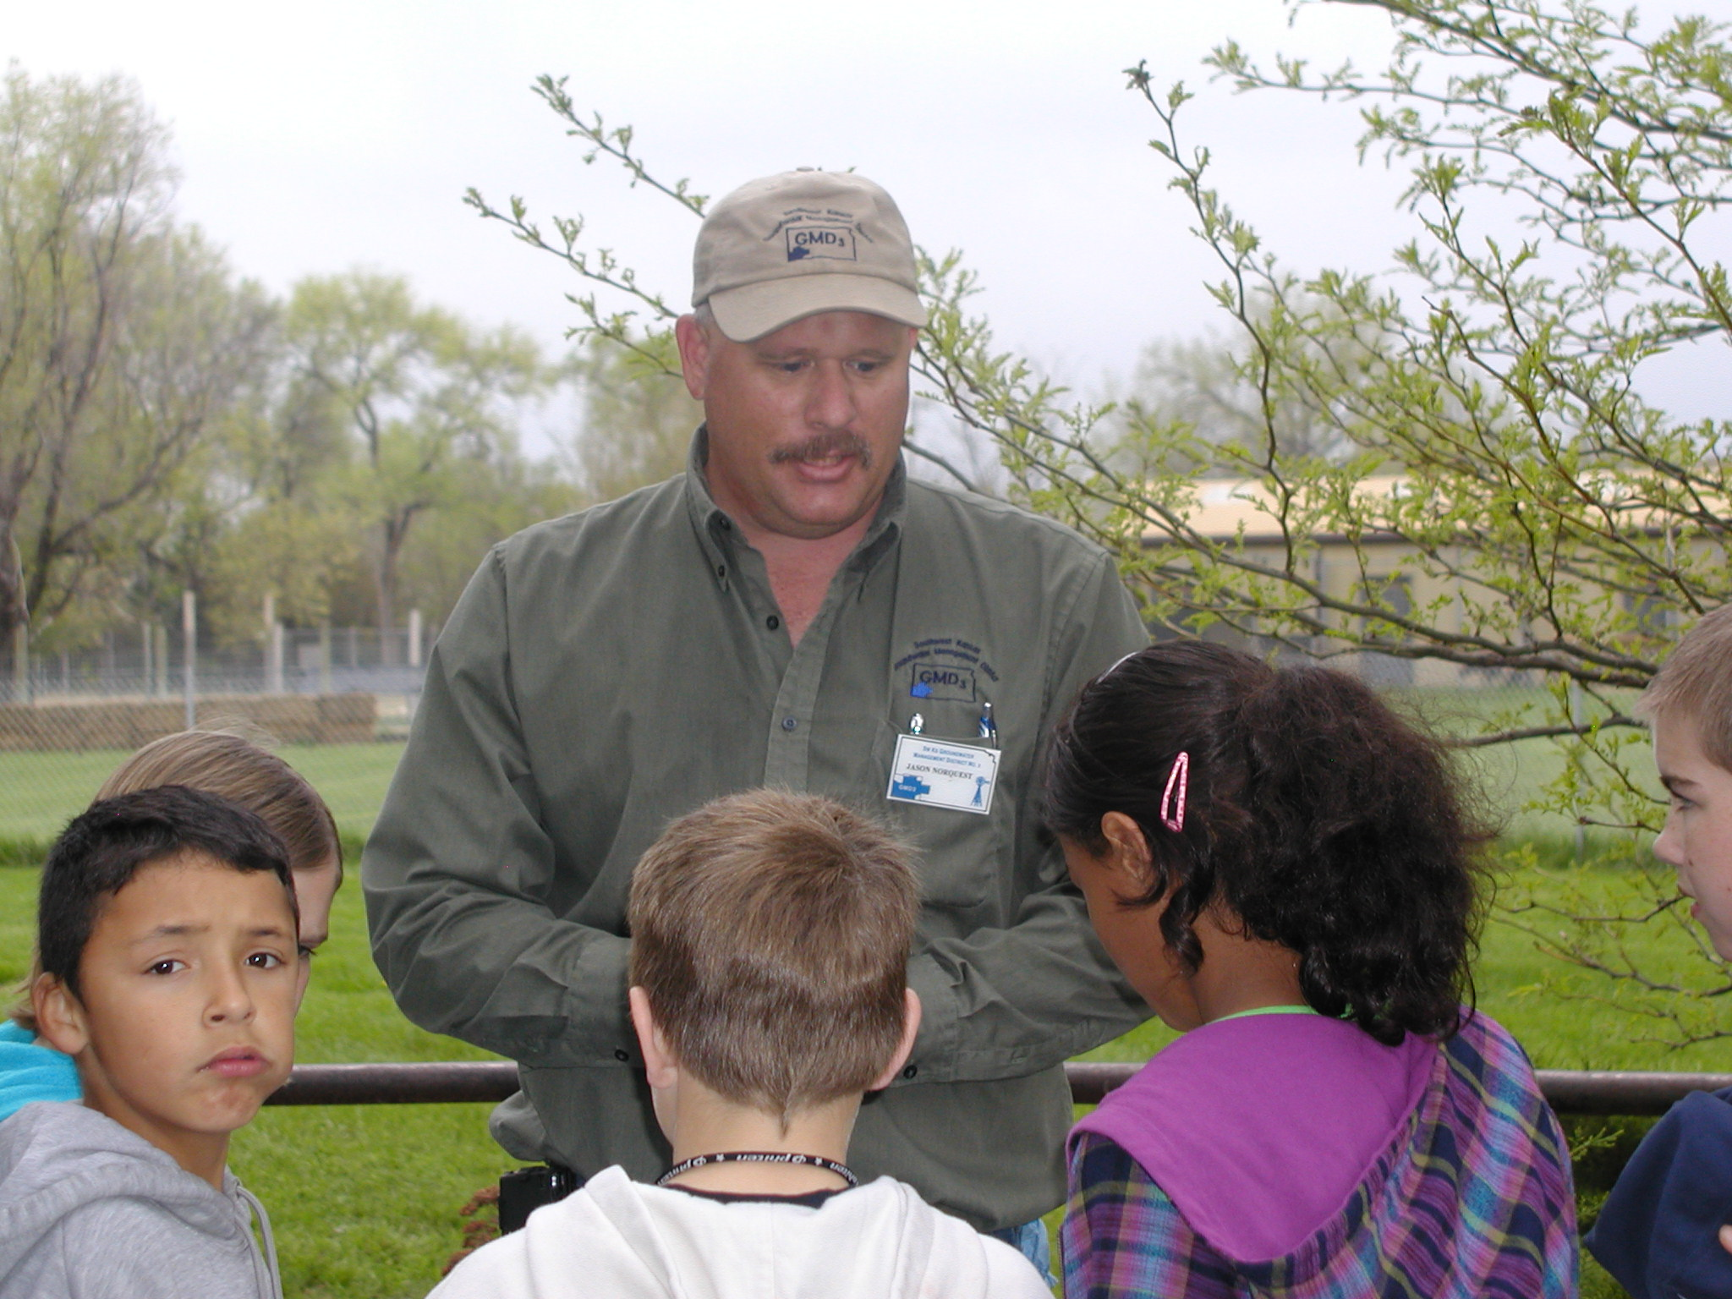
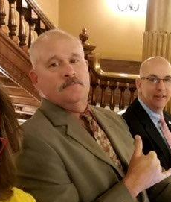
GMD3 Staff
Jason Norquest, 26 yrs.
Assistant manager
  Ag Business
  Water rights
  State applications and reports
  Policy outreach and development
  Classroom instruction
  Techno-geek

Slide 7
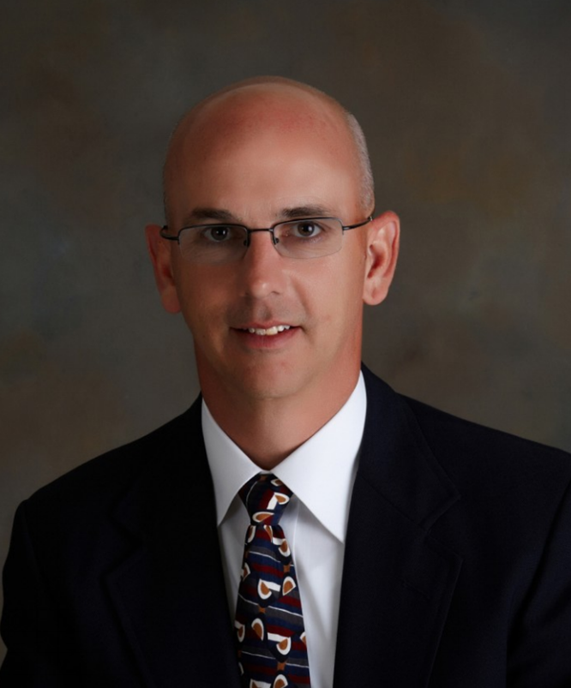
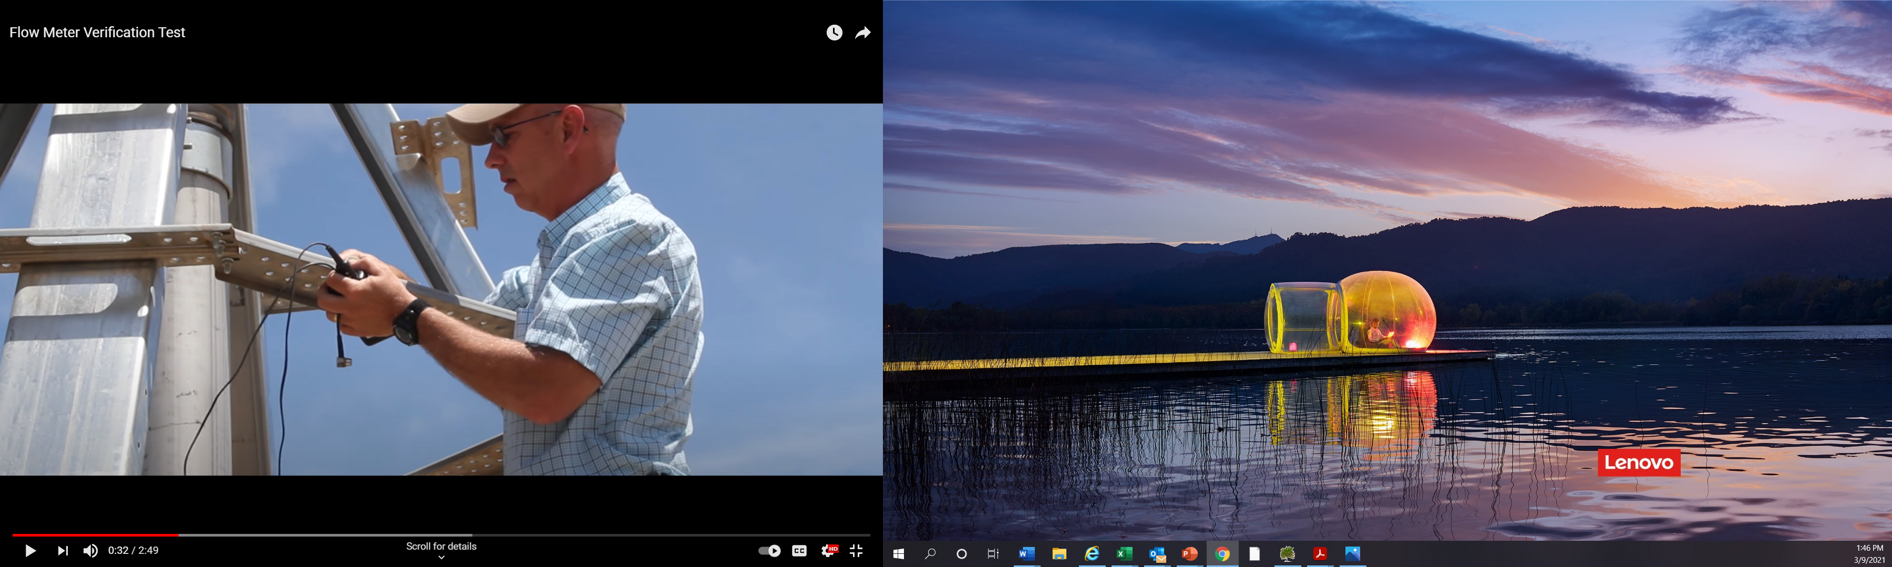
GMD3 Staff
Chris Law, 17 years
Director, Field Services
  Animal Science & Industry
  Local government and policy
  Flowmeters and verification tests
  Water rights assistance
  Conservation field work
  Manage summer field staff

Slide 8
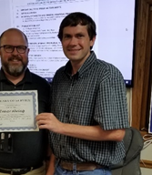
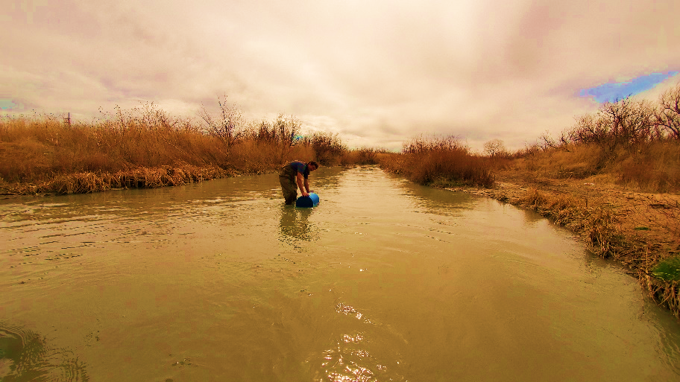
GMD3 Staff
Trevor Ahring, PE, 15 yrs.
Special Projects
  Water Conservation
  Grant writing and reports
  Well & aquifer studies
  Water rights assistance
  Water structures
  Water quality and quantity models

Slide 9
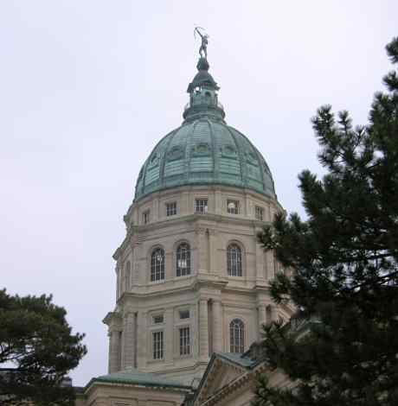
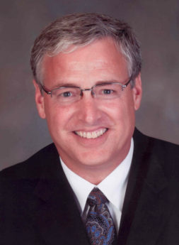
GMD3 Staff
Mark Rude, LG 19 yrs.
Executive Director
  Board engagement
  Management Program
  Member engagement
  Water policy development
  Programs and Partnerships
  Outreach and advocacy
  New projects development
  Staff culture

Slide 10
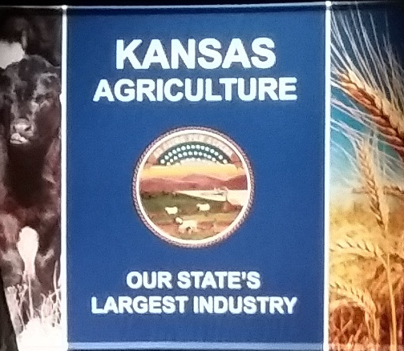

Management Program Update
Hearing TBD - Opportunity to comment and be heard
Notes:
This official Management Program document discusses relationships and interdependent roles of the Groundwater Management District No. 3 (GMD3) with its water management partners to conserve and develop the water resources of the state and achieve the mission of the governing body.

Slide 11
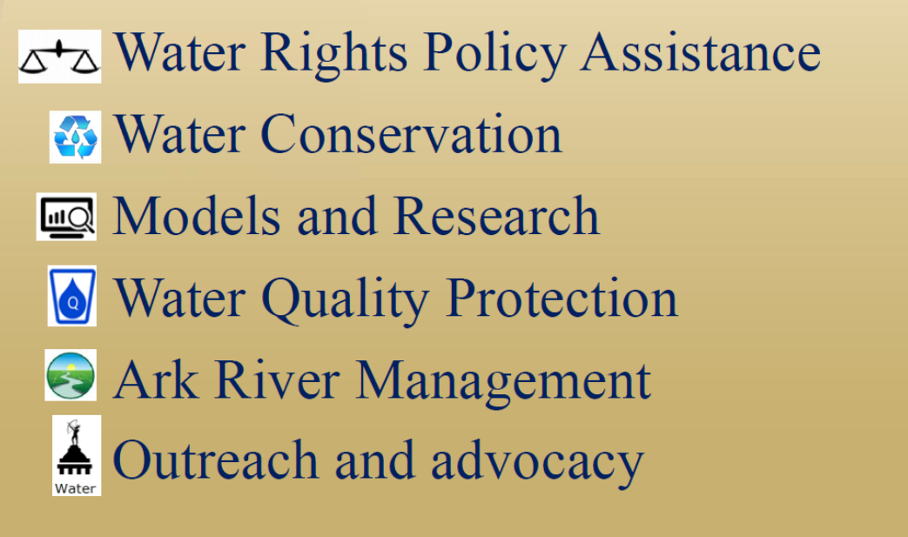




Active areas of the Management Program
Water Rights Assistance
Water Conservation
Water Quality Protection
Models and Research
Ark River/surface water Management
Outreach, Advocacy & Education
Notes:
For GMD3, there are 6 Management Program activity areas that will be reviewed at our annual meeting in March.

Slide 12
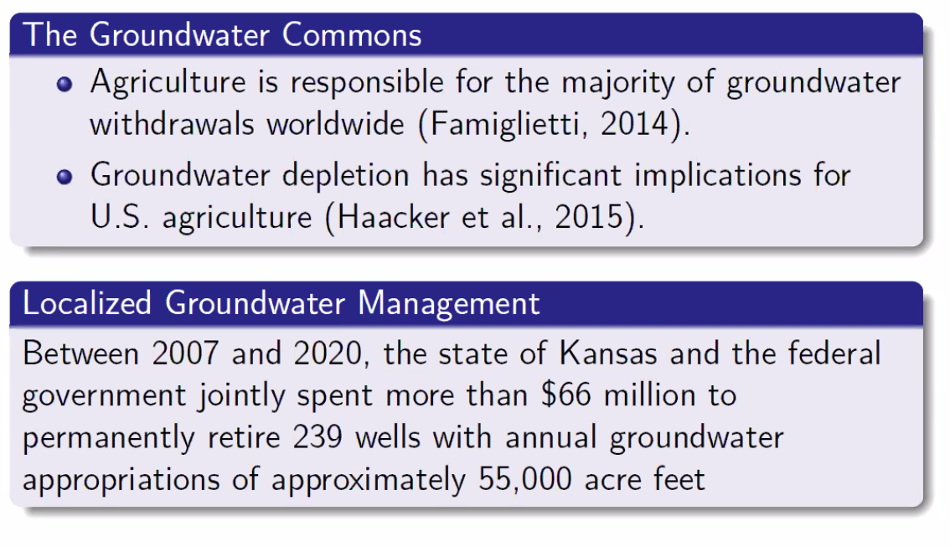
The Groundwater Challenge

Slide 13
Number of county areas served by GMD3 | 12
Number of non-domestic water rights | 12,500
Authorized annual groundwater use | 3.6 million acre-feet
Average annual groundwater use | 1.6 million acre-feet
Average annual recharge from precipitation | 210,000 acre-feet
Average annual return flow recharge (13%) | 208,000 acre-feet returned
Irrigation-enhanced precipitation recharge, inflows from Dakota, streamflow capture. | 622,000 acre-feet gains or return from non-consumptive activity
Reduction of acres irrigated (1989 to 2022) | 175,257 acres
Approximate annual reduction in storage | 500,000 acre-feet
Use reduction the last 10 years (2013 to 2022) vs prior 10-year period | 2 million acre-feet (13.6% reduction)

Slide 14
Posted at GMD3.org
New Legislative Requirements for GMDs

Slide 15

Added to GMD Act in 2023
By July 1, this year - identify all high priority areas with boundaries.
July 1, 2026 - deadline to develop reasonable action plans submitted to the Chief Engineer for approval.
Add the action plans to the MP and Re-evaluate every five years with a report to the Chief Engineer.
If fail any action deadline, the Chief Engineer can act by himself.
Water

Slide 16

GMD3 Water Rights assistance
Permit review - GMD3 conducted 576 technical aquifer studies
Drawdown due to Proposed Use - The proper Theis equation is typically used. Guidelines are posted on GMD3.org.
Local Aquifer (T, S, and boundary) conditions should be based on available information - reasonable but conservative values.

Slide 17
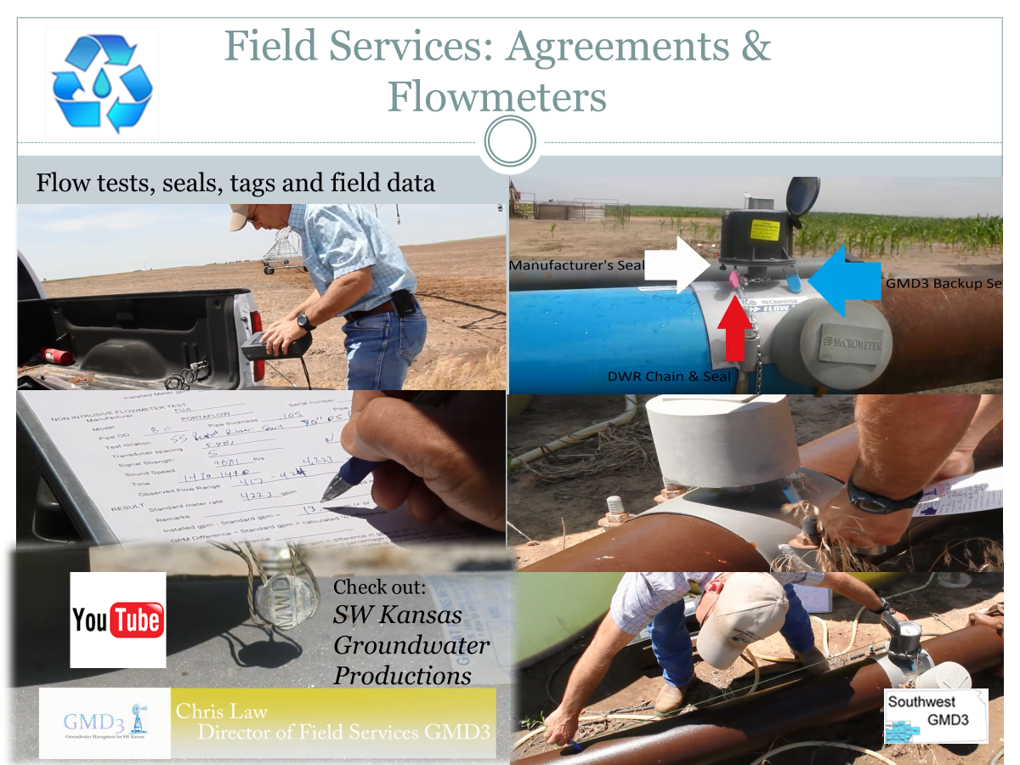
GMD3 Water Rights/ use assistance
Field services – 2500+ field project visits in 2023.
  Flowmeters,
  MOU contracts,
  flow verification tests
  Water Quality sampling
  Special field projects

Slide 18
Water Rights/ aquifer advice and assistance
Rules and regulations – review and feedback to KDA/DWR
  affects Management Program
  Flowmeter regs update
  WCA Rules and Regulations
  Aquifer safe yield screener for redrills.
Reviewed draft statute reform from KDHE.
  Groundwater Exploration and Protection Act

Slide 19

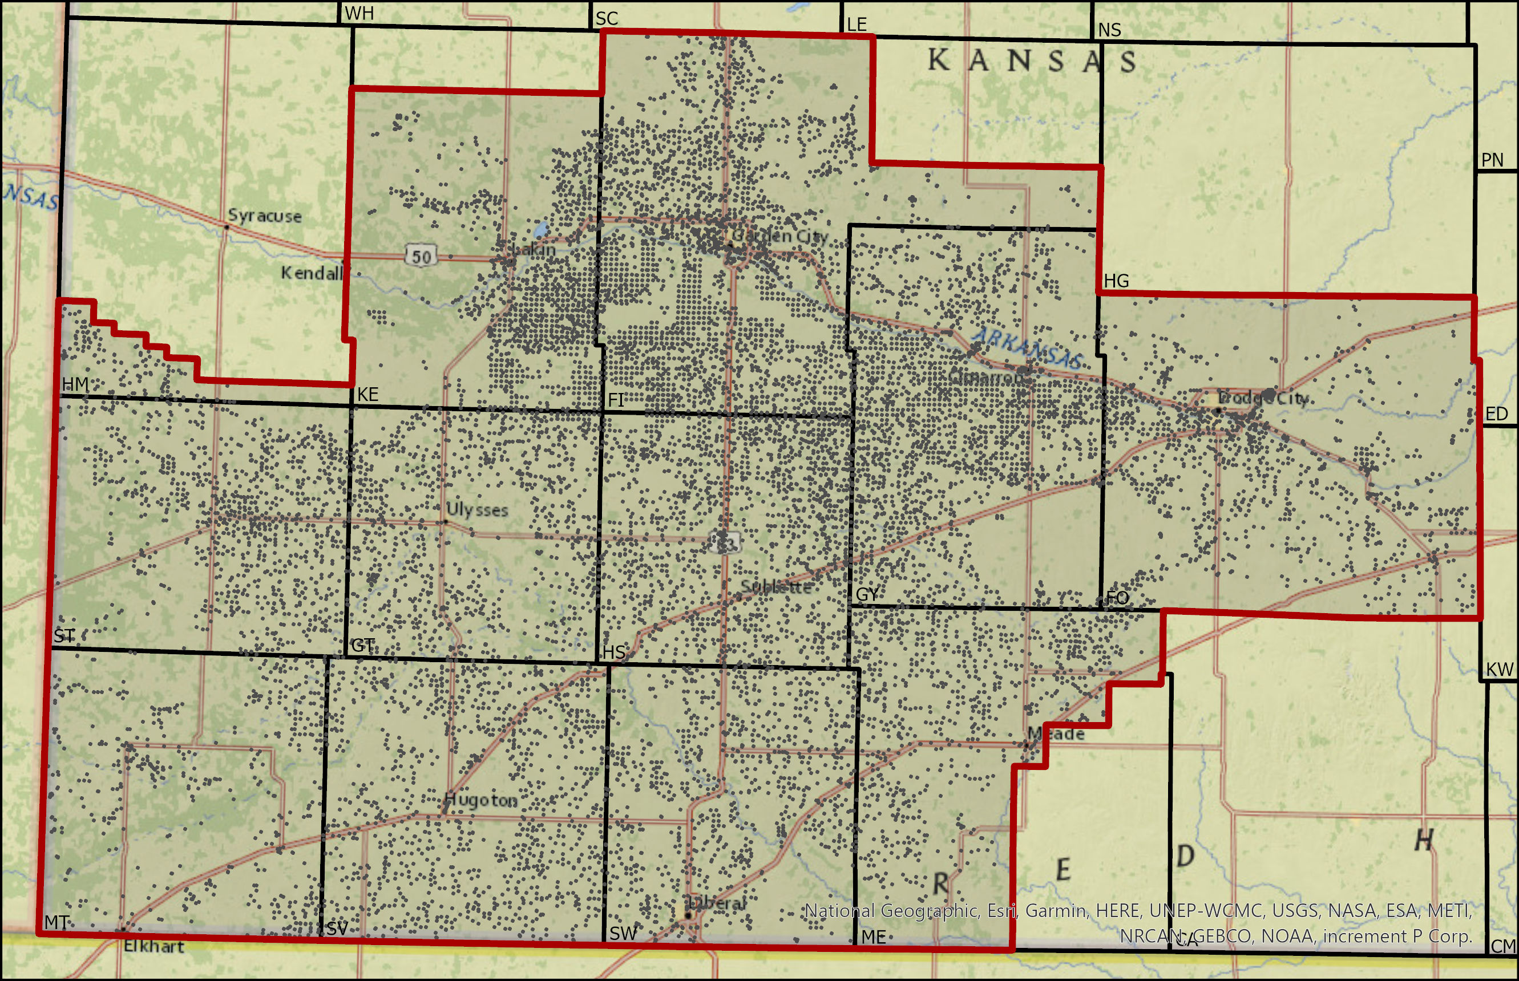

Project Overview and Goals
Provide irrigators individual water use information relative to other “peer” wells
Year 1 (2021-2022): Finney County
Year 2 (2022-2023): All GMD3
2023-2024 forward: Funded by GMD3 members.

Slide 20
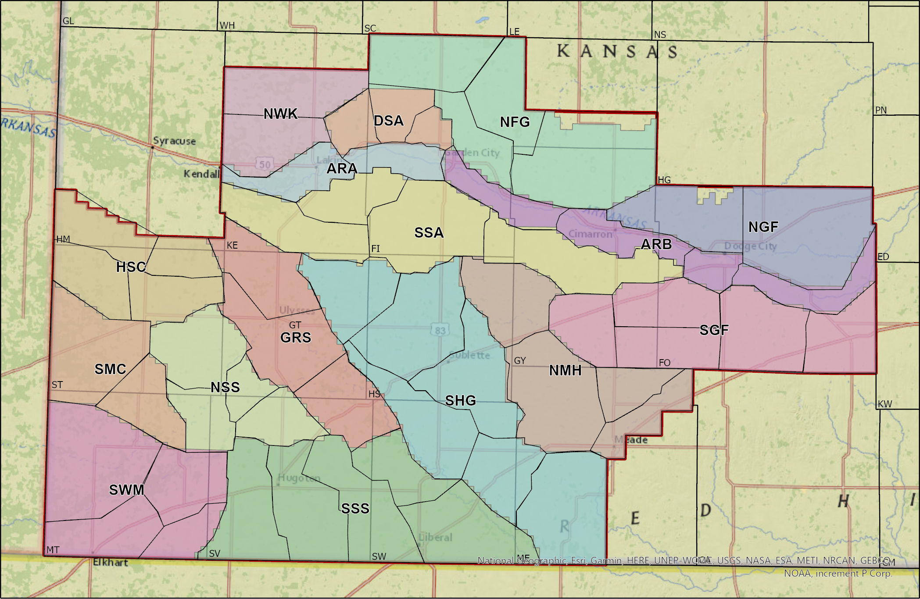

Data driven delineations - aquifer regions and subregions for comparable irrigation wells.

Slide 21
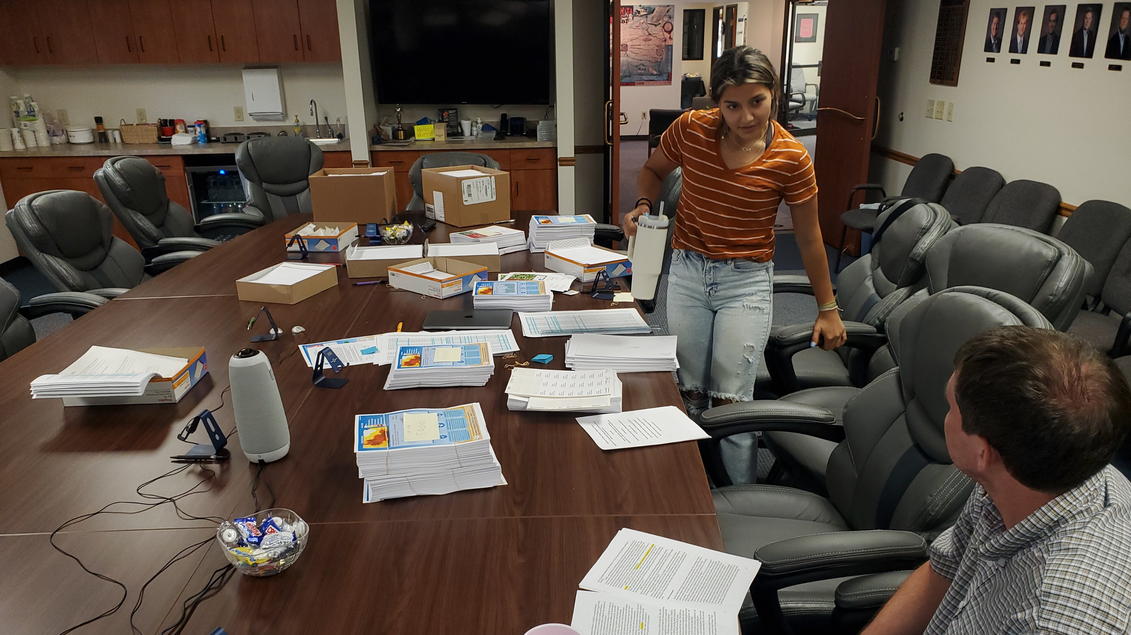

Slide 22
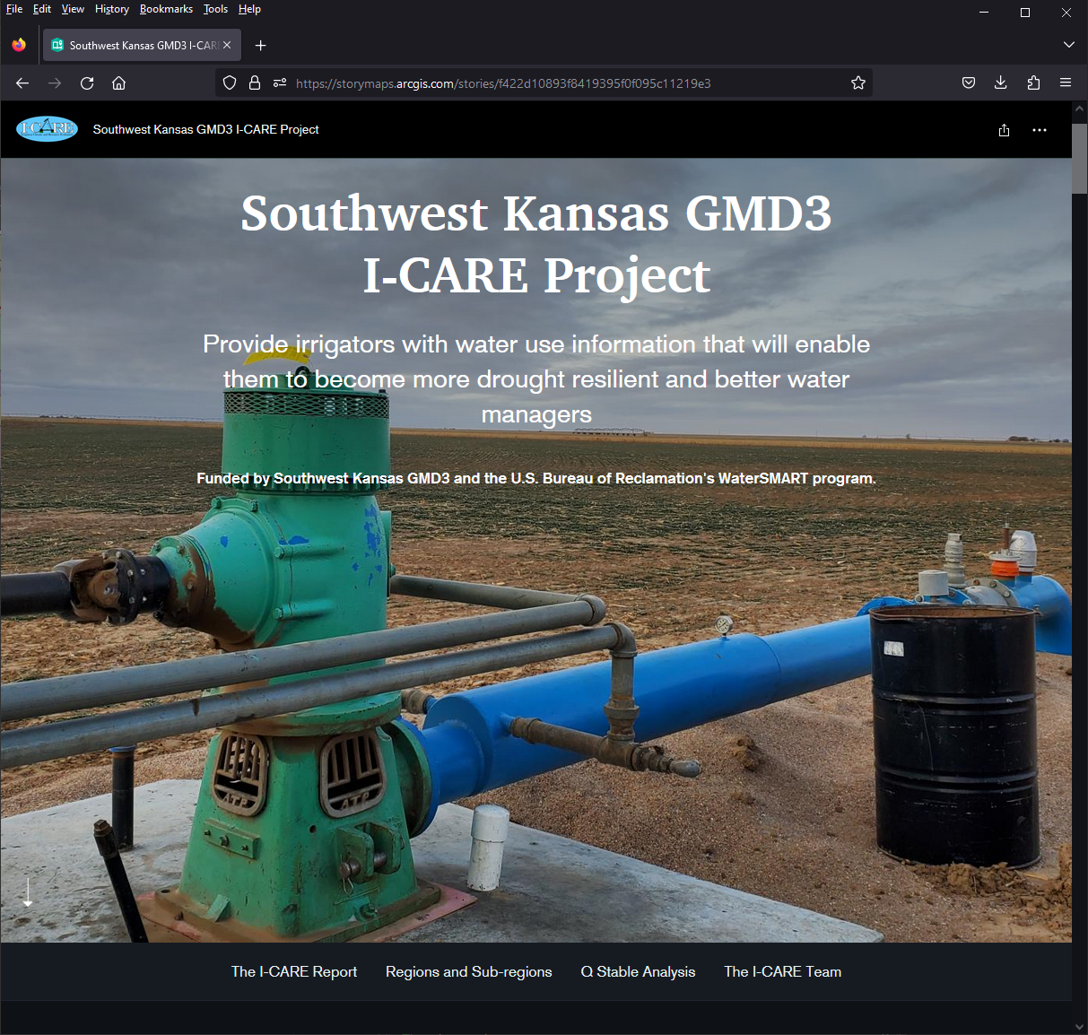
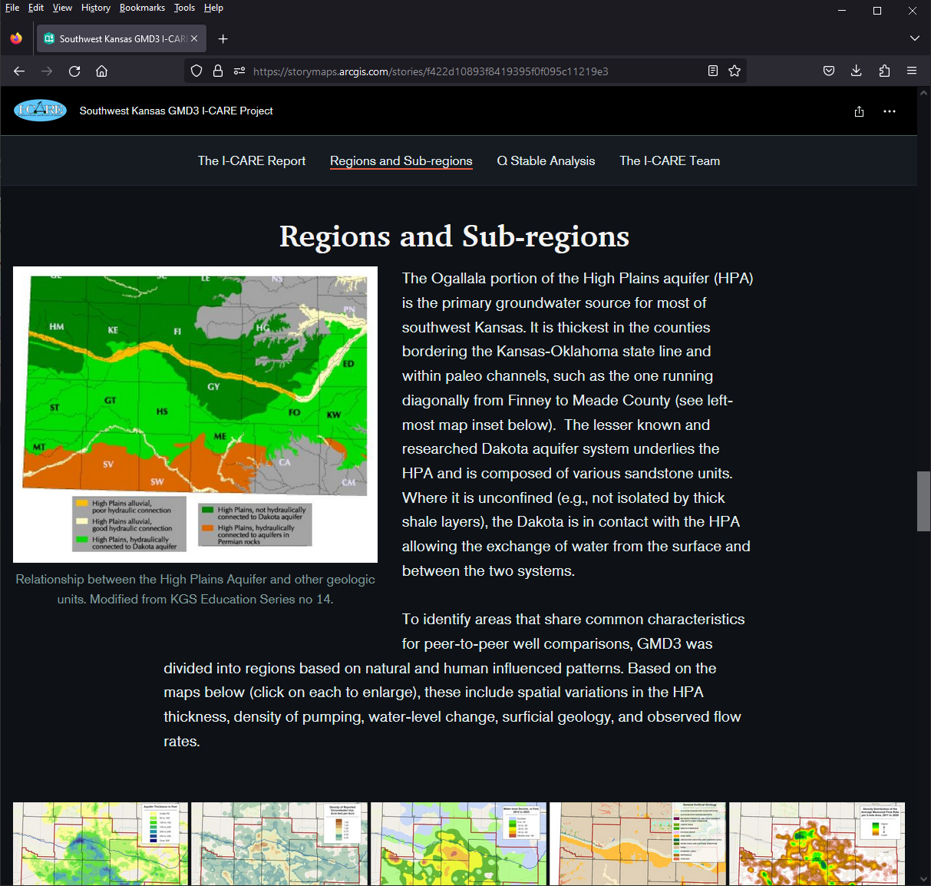
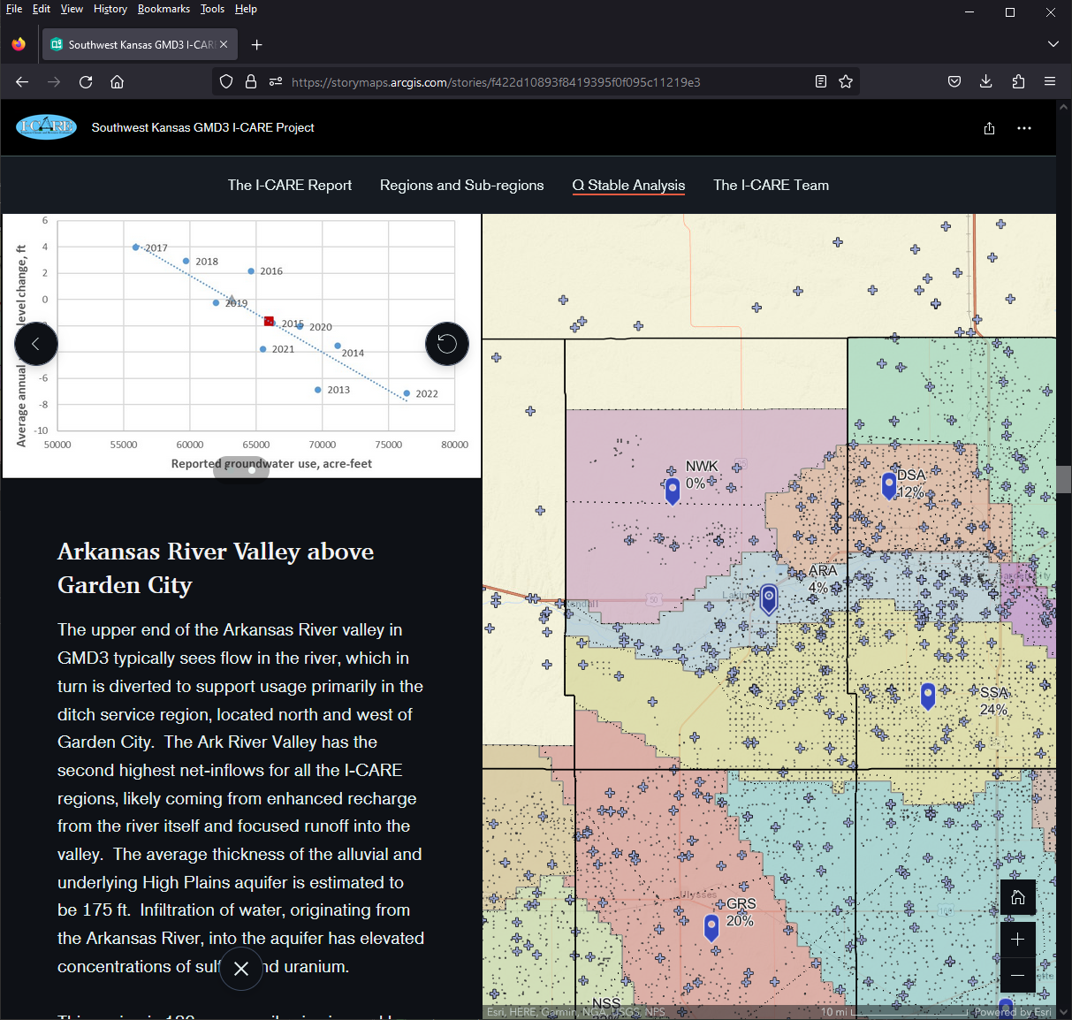
I-CARE Story Map
https://www.gmd3.org/icare

Slide 23
GMD3 SmartPLAN for the path forward
Project will be phased in accordance with the PLAN acronym (Prioritize, Learn, Actuate, Navigate).
GMD3 members over the next two years will:
  learn and provide input on Ogallala conservation and restoration
  help shape their local action plans.
Two grants were submitted to leverage GMD3 expenses for more help
  KSU Research and Extension and other partners.

Slide 24

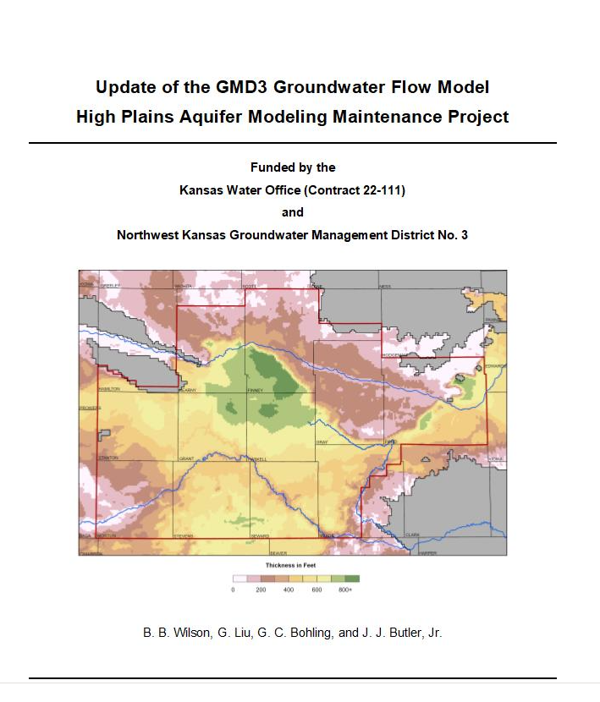
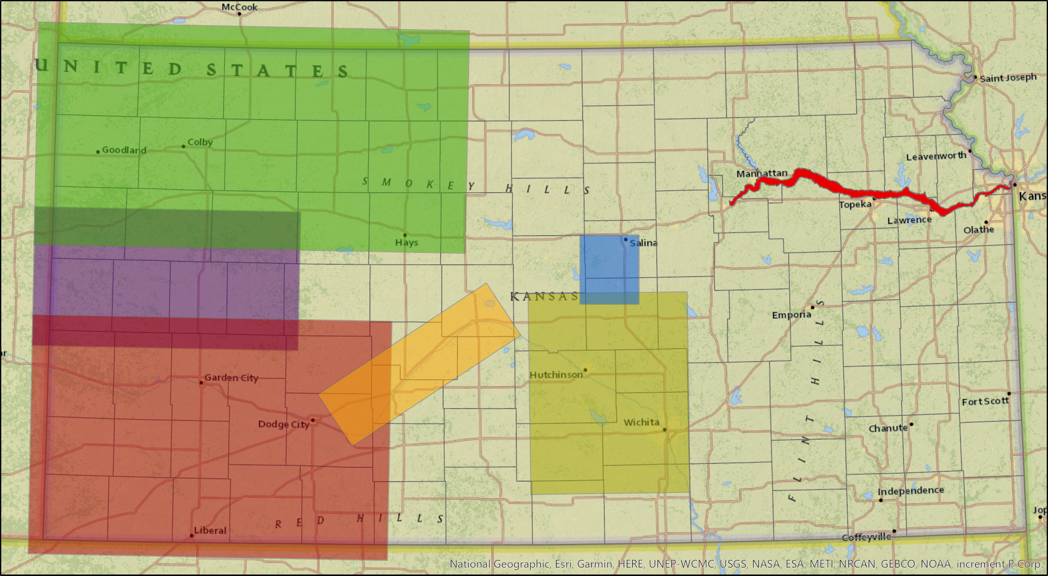

Models, Research & Development
GMD3 Updating the Model w/help from KGS and KWO.

Slide 25
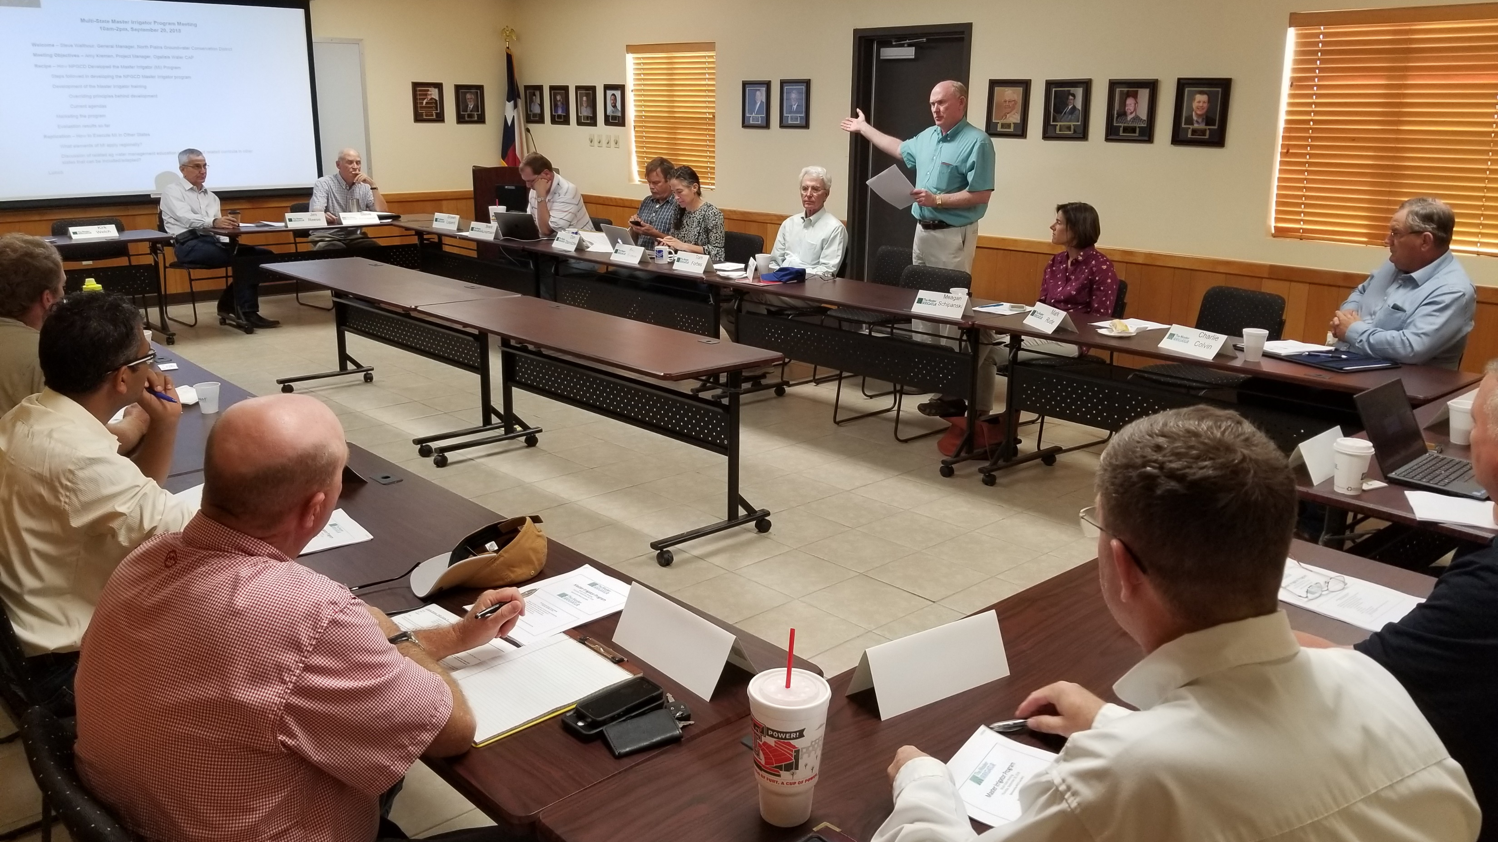
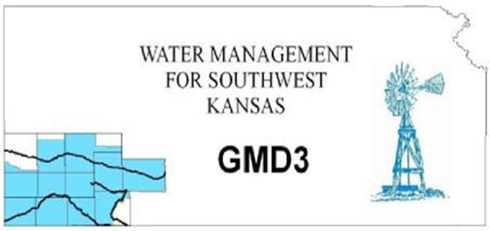
Master Irrigator Program
GMD3 USDA grant submittals to create a statewide Master Irrigator program in each of the Kansas GMDs.

Slide 26

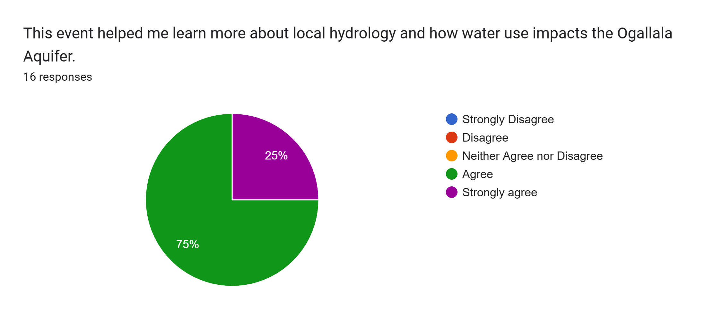
GMD3/KCARE Master Irrigator Lite Event
KSU Kansas Center for Agricultural Resources and the Environment

Slide 27
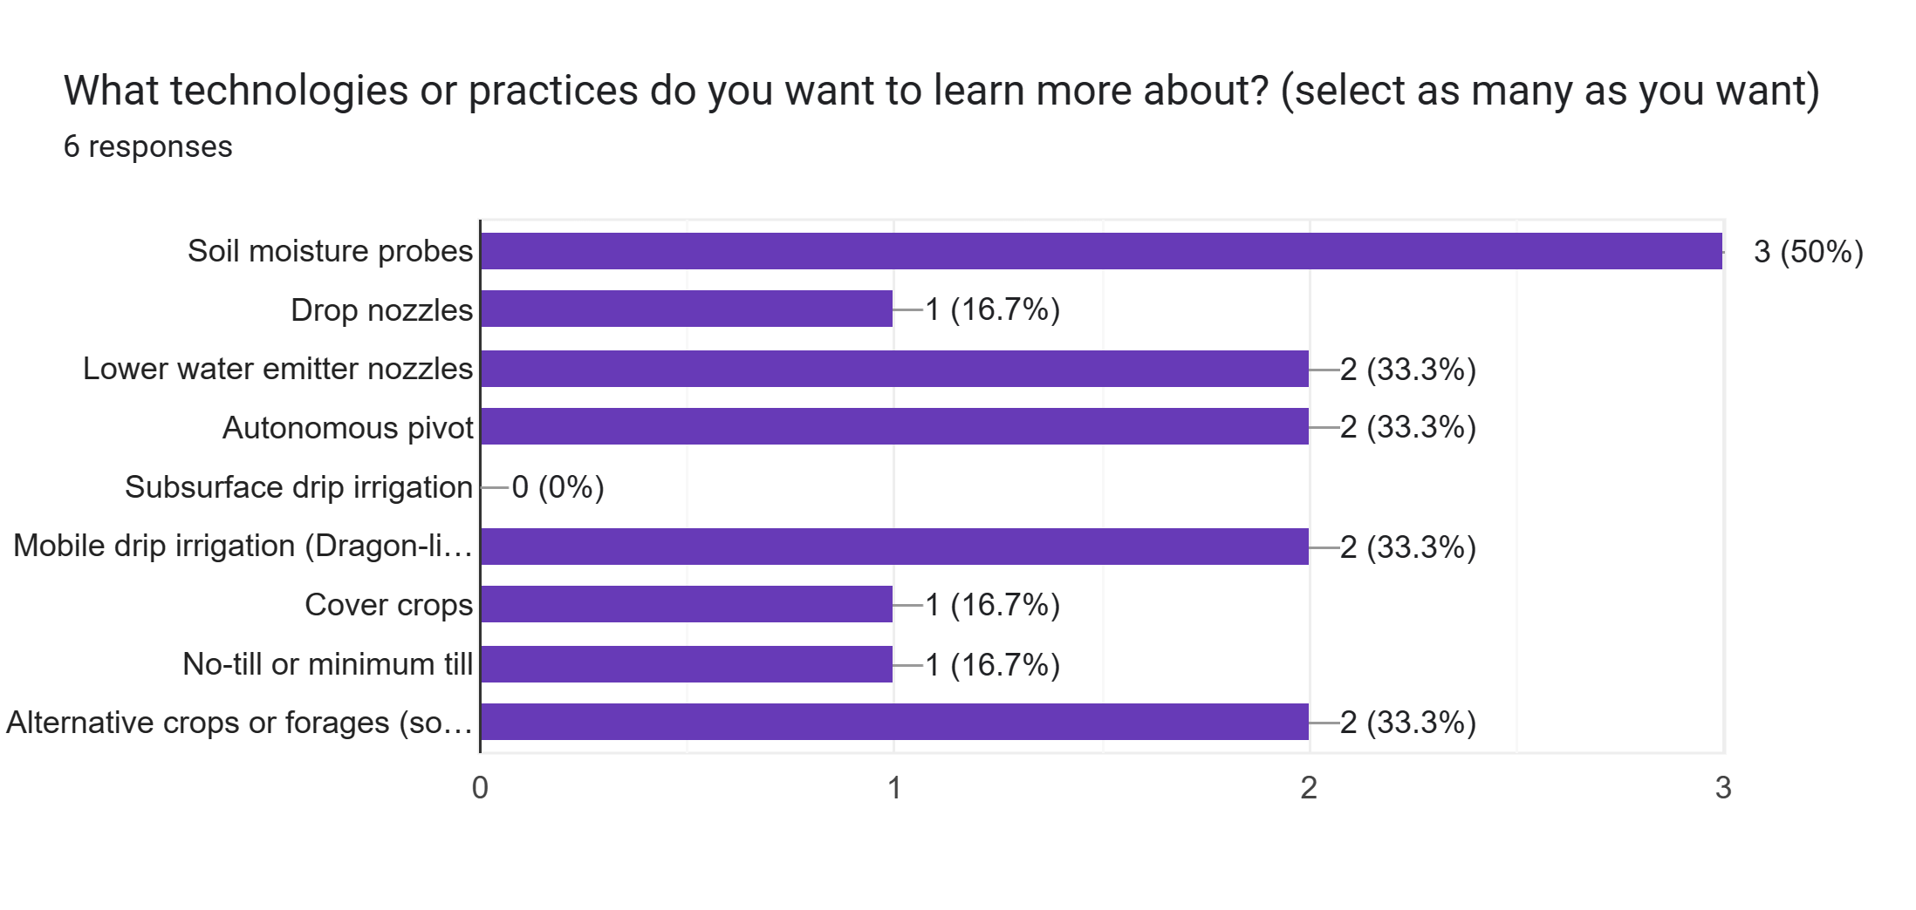

Slide 28
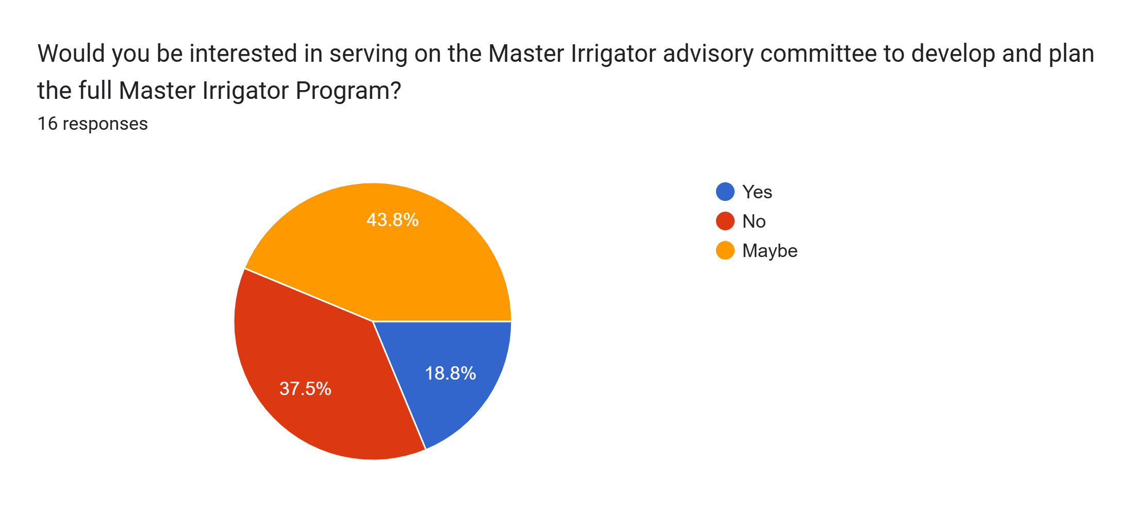

Slide 29

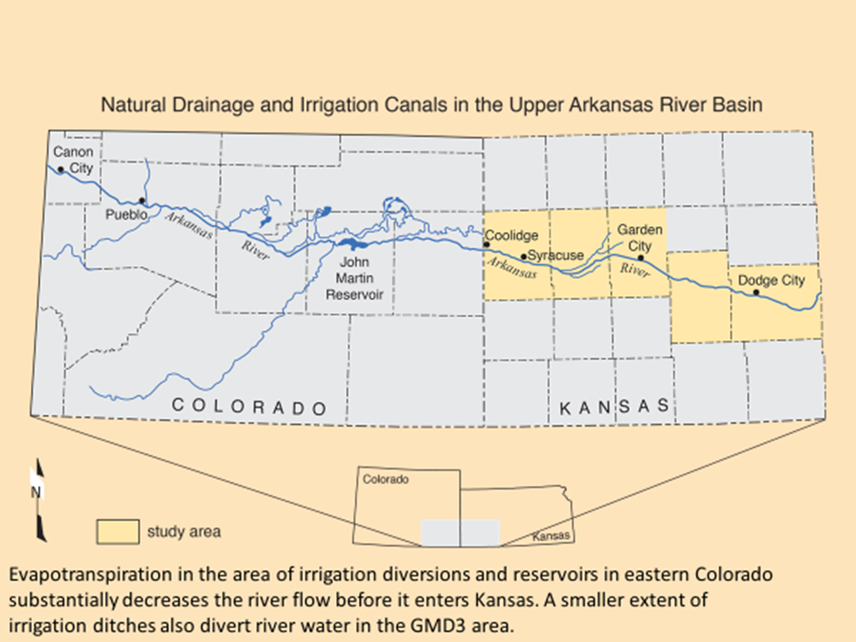



Ark River shared basin
Tons of uranium delivered to Kansas and GMD3 each year…
Colorado - new JMR storage account
Colorado - Ark Valley Conduit federal funds to contaminated community drinking water.
Colorado/Kansas water quality summit.
NWQA planning grant for GMD3 w/KDHE
Upper Ark Watershed Group Annual Mtg.
City of Deerfield drinking water alternatives.
Collaborative Ark River Management activities.

Slide 30
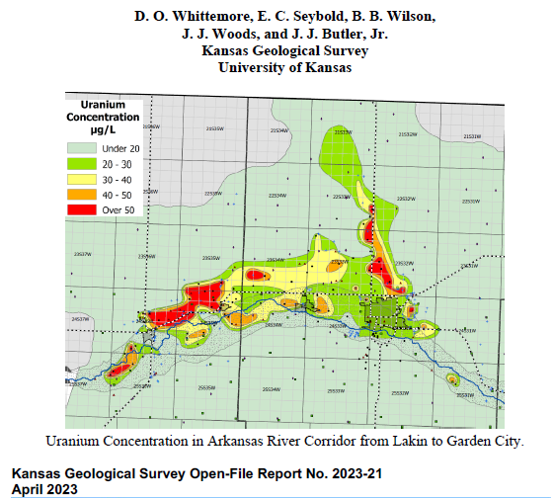
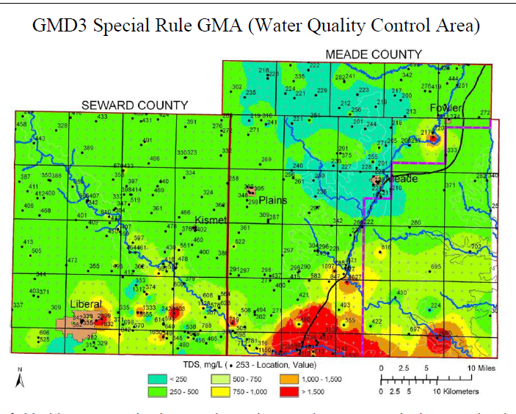
  GMD3 Assisted the KGS mineralization study and other requests by collecting river and groundwater quality samples and corresponding with well owners in study areas.

Slide 31
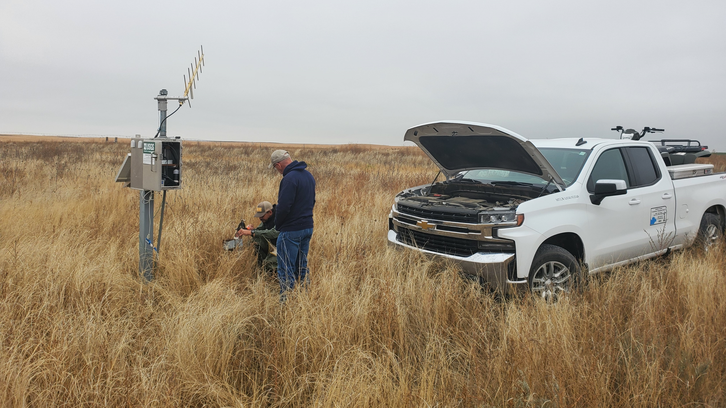
Stateline Groundwater gages – Water samples

Slide 32
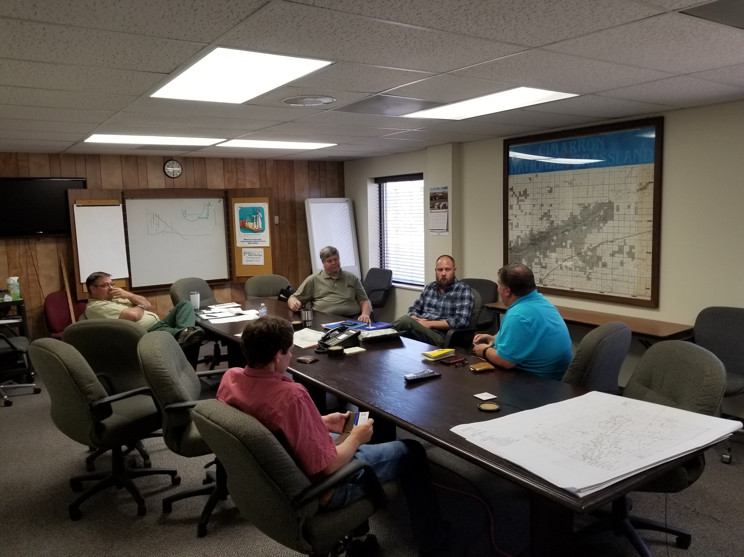

Cimarron River /High Plains Aquifer.
Oklahoma and Colorado interests
Partnered w/ USGS, Forest Service & KGS for data

Slide 33







GMD3 Policy Outreach and Advocacy

Slide 34
Kansas Legislature 2024 update
Carry over bills
HB 2459 - Prohibiting a P/D change when safe yield exceeded – we opposed – bill did not move.
GMD Act - New this year
HB 2695 – eligible voters to petition the chief engineer directly to extend or reduce the GMD territory – we opposed – bill did not move.
HB 2696 –GMDs - “written comment” rather than “a recommendation” for a proposed WCA plan – we opposed – bill did not move.
HB 2697 – Reduce the power of a GMD to provide “relevant information” rather than “advice and assistance” regarding groundwater management and other appropriate matters of concern. – we opposed limiting the local say – bill didn’t move.
“Turn around” deadline has passed so above bills are done.
HB 2634 - Adds MYFA-like flexibility as option in a LEMA or IGUCA order – passed the house and hearing today in Senate committee – support management flexibility without injury to others.

Slide 35


Kansas Water Congress reorganization:
A nongovernment nonpartisan association a steering committee forming to nominate a new board and members across Kansas. www.kansaswatercongress.org

Slide 36

GMD3
Jason Norquest, GMD3, currently serves as President of this national organization.
1977 Groundwater Management and Recharge workshop

Slide 37


NWRA 2024 FEDERAL LEADERSHIP FORUMS

Slide 38

National Water Resources Association
Board officers 2024
President – Craig Simpson, Washington state
Vice President – Clay Scott, Kansas (GMD3)
Treasurer – Paul Arrington, Idaho
State Executives – Doug Kemper, Colorado
Federal Affairs Committee – Christine Arbogast, Colorado

Slide 39
GMD3 Federal policy work to save groundwater
Federal groundwater conservation economics.
  Revenue Rule 65-296 - allows people who extract groundwater from the Ogallala Aquifer to file a cost depletion deduction for the loss of groundwater as it declines.
  GMD3 is working for Tax code options for compensated groundwater savings in perpetuity before it’s gone.

Slide 40
GMD3 Federal policy examples
Inflation Reduction Act
Working w/ Kansas delegation and Dept. of Interior staff, along with the Kansas Governor, to encourage Reclamation to extend the $800 million IRA Drought funding into Kansas.
Farm Bill
“The Voluntary Groundwater Conservation Act of 2023” in HR4902 & S2250
  Creates a new Groundwater Conservation Easement Program at USDA.
  Allows NRCS to reimburse transaction costs to 5 percent of federal share.
  Guarantee long-term management flexibility for a producer.
  Ensure that farmers are fairly compensated for their conservation.

Slide 41
Things to watch for:
CREP water right retirement – incentives at all time high
Voluntary Groundwater Conservation Easement – Farm Bill
GMD3 Regional Water meetings this summer and next.
Water Quality testing assistance for uranium in Ark River Counties.
Next two years – Reasoned action plans for your Aquifer sub-region.
Next five years – RCPP Kansas - New people in GMD3 office to assist you with irrigation water saving practices and technology.
Master Irrigator Program and TAPPs competition development

Slide 42

Parcels in the District
(estimated from 2022 County data)
GMD3 Funding Data
Over 40 acres = 29,347
Owner lives In District = 19,590
Out of District in Kansas = 3,826
Owner lives in Kansas = 23,416
Lives outside Kansas = 5,931
Member Landowners – $0.05/ac.
Total parcels (including under 40ac) = 79,559
Notes:
20% of parcels have out of state ownership.

Slide 43
2023 Audit Presentation

Slide 44
2024 Proposed Budget Revision

Slide 45
Assessments compared - Land and Water
GMD NAME |  | LAND |  | WATER
 |  | ASSESSMENT |  | ASSESSMENT
 |  | CHARGE |  | CHARGE
Western KS GMD1 |  | $0.05 |  | $0.50
Equus Beds GMD2 |  | $0.05 |  | $1.50
Southwest KS GMD3 |  | $0.05 |  | $0.22
Northwest KS GMD4 |  | $0.05 |  | $0.349
Big Bend GMD 5 |  | $0.05 |  | $2.00
USER FEE
GMD3 - Water User Fee stayed at $0.16 per acre-foot for 2024 budget but now propose 2nd budget hearing to access some of $371,836 carryover from 2023.

Slide 46
Cash based General Fund Budget for 2024
SW Kansas Groundwater Management | Adopted
District No. 3 | Budget
 | 2024
Receipts:
*Assessment Total | $833,332
Interest | $3,000
MOU Contract Income | $13,000
Transfers from other funds
Misc. Income
Total Receipts | $849,332
Expenditures:
Conservation Programs | $155,000
Salaries and Benefits | $645,000
Office Expense | $115,000
Education and Advocacy | $140,000
Contractual Services | $60,000
Capital Outley | $35,000
Contingencies | $69,327
Total Expenditures | $1,219,327
Other Board funds :
WWCP Fund. The WWCP Fund ended FY 2023 with $364,770.73 in cash and investments. The annual report for this fund is attached to this 2023 GMD3 Legislative Annual Report as Attachment A.
Water Rights Retirement Fund. up to the amount of $25,000,000 as a separate fund from the District General fund for the retirement of water rights within the District. That fund is unfunded.
Kansas Aqueduct Project Fund - $25,000,000. That fund is unfunded.
Federal Proceeds Fund. This Fund of up to $25,000,000 is a separate fund from the District General fund and administered by the District. The Federal Proceeds fund will be changed in name to Grant Proceeds Fund to be used to administer state and federal grants.

Slide 47
Cash based General Fund Budget for 2024
SW Kansas Groundwater Management | Adopted
District No. 3 | Budget
 | 2024
Receipts:
*Assessment Total | $833,332
Interest | $3,000
MOU Contract Income | $13,000
Transfers from other funds
Misc. Income
Total Receipts | $849,332
Resources available | $1,221,168
Expenditures:
Conservation Programs | $155,000
Salaries and Benefits | $645,000
Office Expense | $115,500
Education and Advocacy | $140,000
Contractual Services | $60,000
Capital Outley | $35,000
Contingencies | $69,327
Total Expenditures | $1,219,827
Proposed revision to the2024 budget
The GMD3 Board recognizes there is $371,836 of unencumbered cash carryover revenue from FY 2023 assessments and grant reimbursed staff time that is unavailable as it was not budgeted in 2024. To become available this year, the Board is proposing a revised 2024 budget and a hearing on the revised budget, likely to be held in July at a similar time and place as the hearing on the 2025 proposed budget.
The Board proposes to use a portion of the carryover to fund certain staff salary adjustments and a new temporary Irrigation Conservationist position consistent with inflation and market levels. Additional finds may be needed to cover SmartPLAN expenses if grants are not awarded.
The new temporary Irrigation Conservationist position is to allow immediate hire and training ahead of an NRCS RCPP Kansas grant agreement with KDAs Division of Conservation that plans to place two such positions in each GMD office wholly funded by the federal grant.

Slide 48
2025 Draft Proposed Budget and Assessments

Slide 49
Assessments compared - Land and Water
GMD NAME |  | LAND |  | WATER
 |  | ASSESSMENT |  | ASSESSMENT
 |  | CHARGE |  | CHARGE
Western KS GMD1 |  | $0.05 |  | $0.50
Equus Beds GMD2 |  | $0.05 |  | $1.50
Southwest KS GMD3 |  | $0.05 |  | $0.22
Northwest KS GMD4 |  | $0.05 |  | $0.349
Big Bend GMD 5 |  | $0.05 |  | $2.00
USER FEE
GMD3 – Water User Fee proposed to be raised to $0.22 per acre-foot for 2025 unless additional grant funding and savings carryover from 2024 can be realized.

Slide 50
DRAFT proposed Cash based General Fund Budget for 2025
SW Kansas Groundwater Management | DRAFT Proposed
District No. 3 | Budget
 | 2025
Receipts:
*Assessment Total | $1,045,332
Interest | $20,000
MOU Contract Income | $13,000
Transfers from other funds
Misc. Income
Total Receipts | $1,078,332
Resources Available (add carryover) | $1,250,332
Expenditures:
Conservation Programs | $145,000
Salaries and Benefits | $775,000
Office Expense | $106,000
Education and Advocacy | $138,000
Contractual Services | $58,000
Capital Outley | $5,000
Contingencies | $23,332
Total Expenditures | $1,250,332
Proposed 2025 budget
The GMD3 Board recognizes proposed draft budgets and assessments can be lowered after the July hearing. A portion of the $371,836 unencumbered cash carryover accessed in 2024 is subject to a July hearing. Grant reimbursed staff time and expenses may add to 2024 year-end carryover into 2025. More will be known on awarded grant revenue by the July hearing on the 2025 budget expected to allow a lower water user fee than $0.22 per acre-foot.
By July, more should be known about grants to cover costs, including the of two irrigation conservationist positions and allow the board proposed new GMD3 temporary Irrigation Conservationist position to move into one of those positions.
Again, the new temporary Irrigation Conservationist position is to allow immediate hire and training, including federal TSP training on conservation practice most requested by GMD3 members ahead of an NRCS RCPP Kansas grant agreement with KDAs Division of Conservation.

