Slide 1
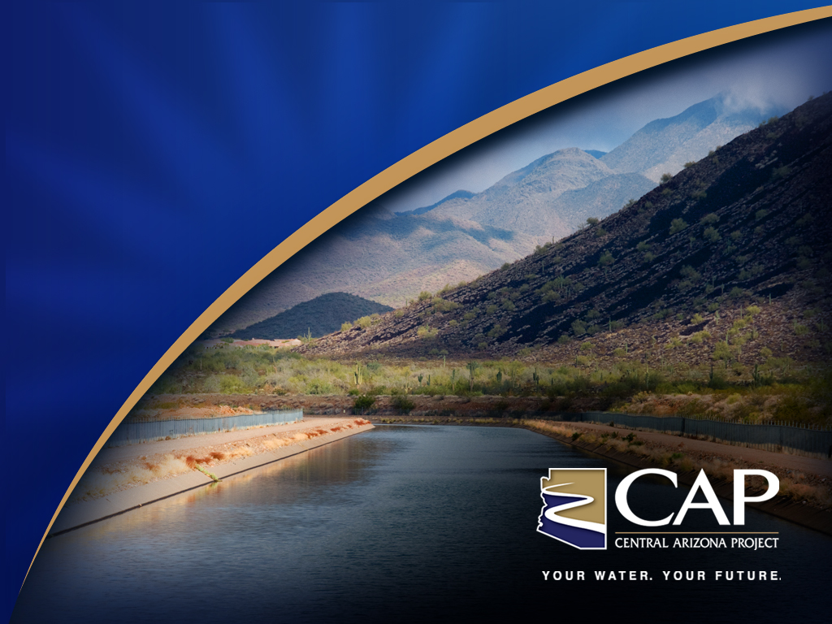
Central Arizona Project
Thomas W. McCann
January 7, 2015

Slide 2
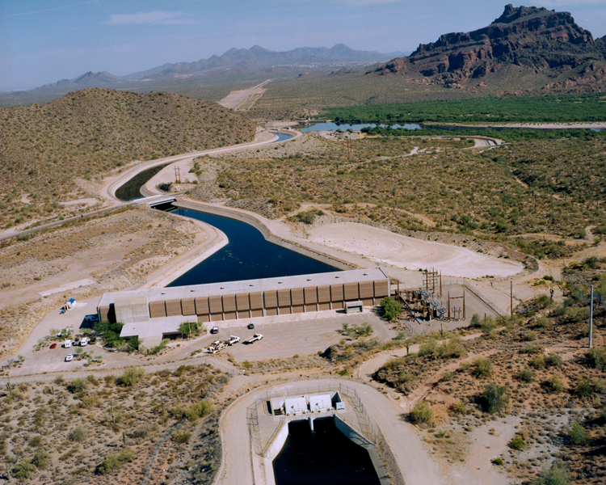
Central Arizona Project
History
Physical System
Operation
Governance
Contracting
Finances

Slide 3

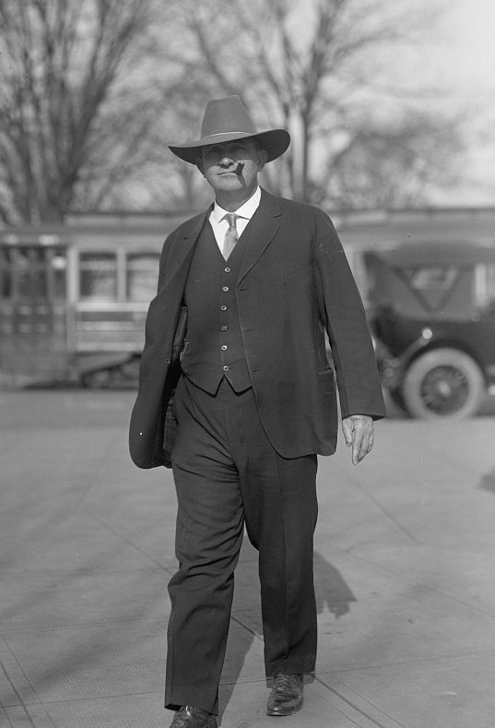
Origins
Concept of a large-scale project to bring Colorado River water into central Arizona dates to at least the early 1900s
In 1922, engineers surveyed an aqueduct route from Parker to the Salt River valley
Representative Carl Hayden
Notes:
1916

Slide 4
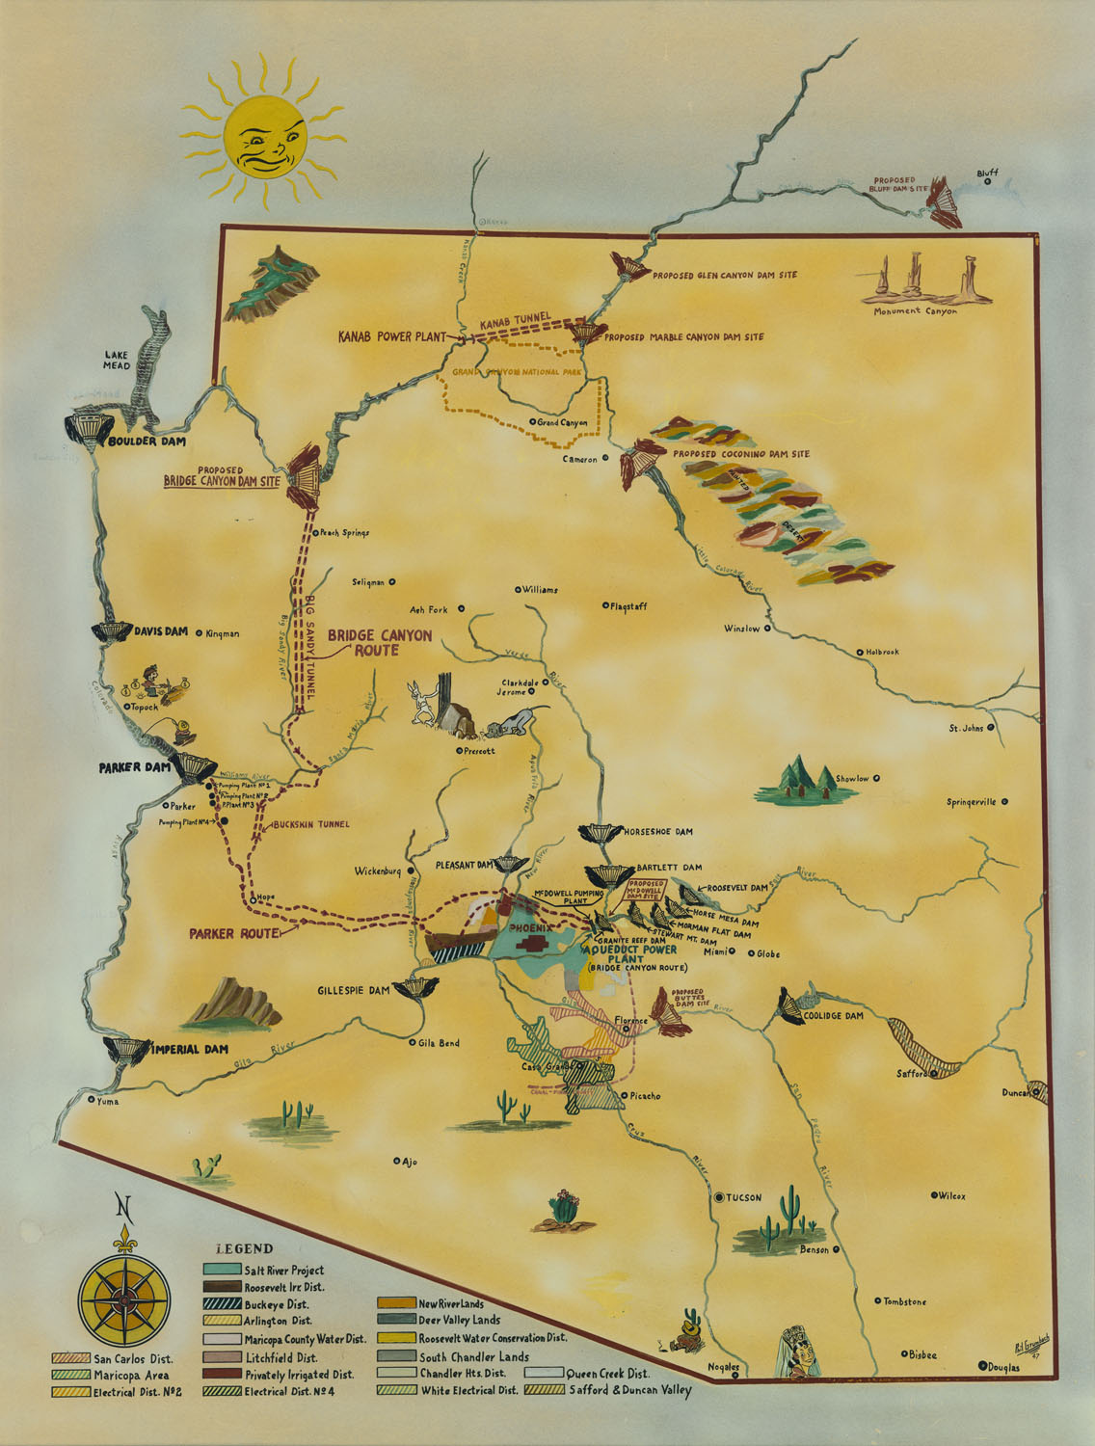
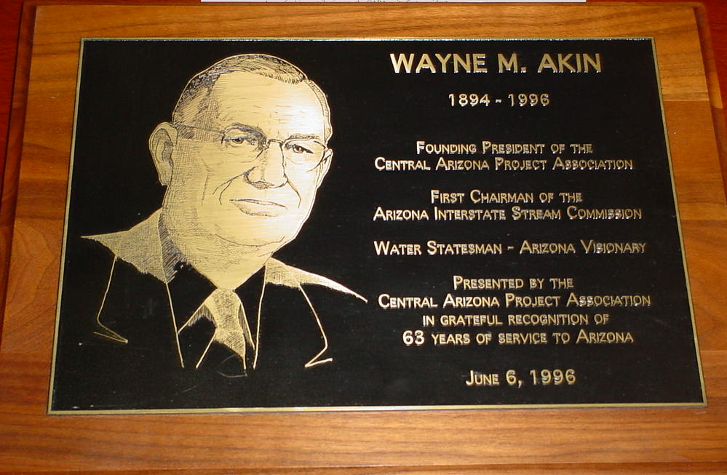
Business Community Support
Central Arizona Project Association formed in 1946 to support congressional authorization of CAP

Slide 5
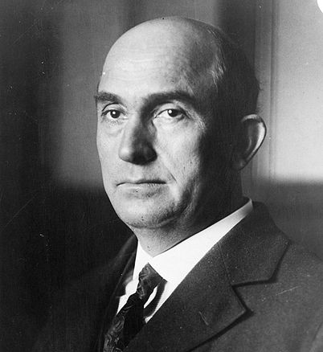
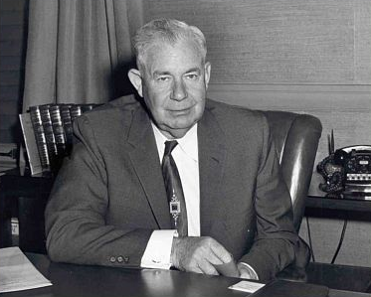
Political Support
Arizona’s Senators secured passage of CAP bills in 1950 and 1951, but California blocked Arizona in the House of Representatives
Senator Ernest McFarland
Senator Carl Hayden
Notes:
Arizona delegation worked cooperatively, regardless of party affiliation to make CAP a reality

Slide 6
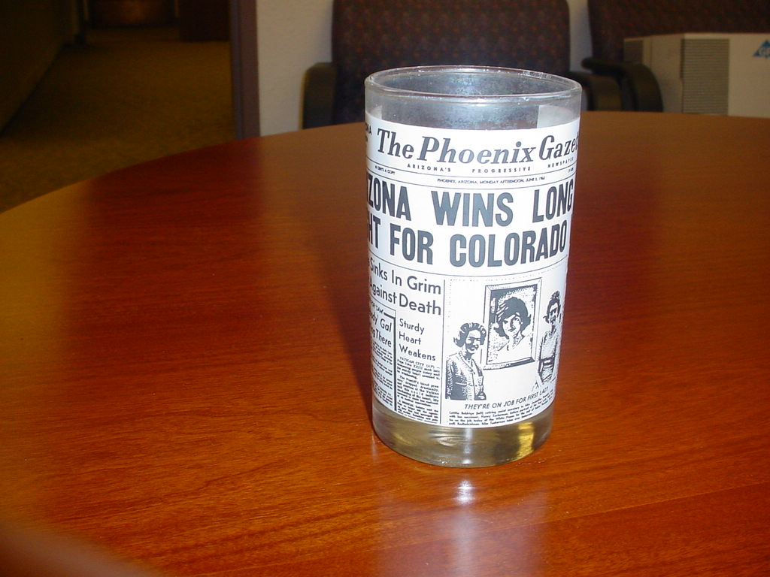
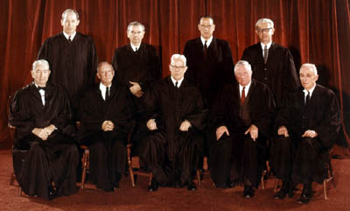
Legal Action Required
Arizona v. California filed in 1952, decided by Supreme Court in 1963, confirmed Arizona’s rights to Colorado River water

Slide 7
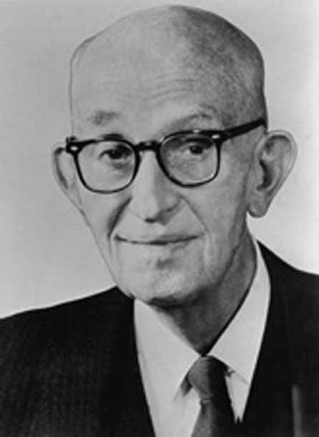
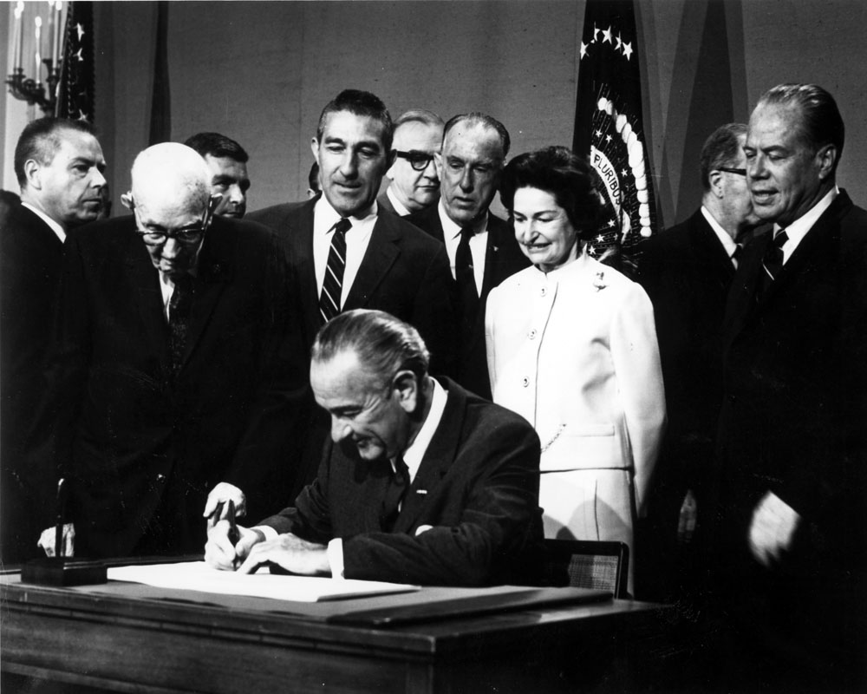
Legislative Compromise
Colorado River Basin Project Act of 1968 authorized the CAP, but Arizona had to give California senior priority to the Colorado River
Senator Carl Hayden

Slide 8
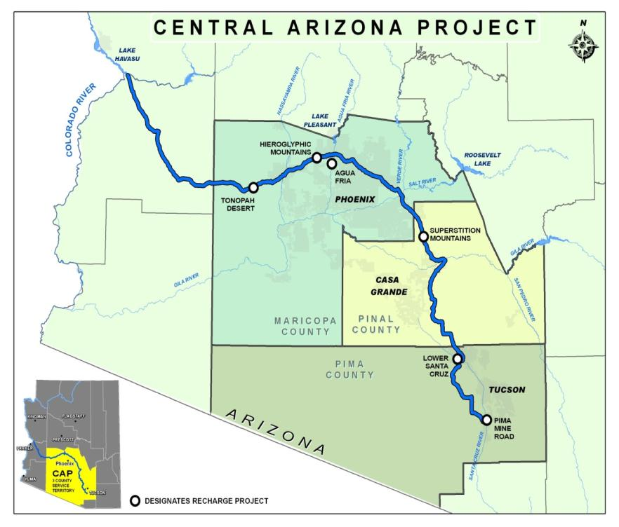
Physical System
336-mile aqueduct
14 pumping plants
8 siphons
3 tunnels
Regulatory reservoir
Navajo Generating Station
ARIZONA
Notes:
CAP is largest source of renewable water for AZ
1.6 million AF/year (521 billion gallons)
Serves 3 counties containing 80% of Arizona’s population
CAP has 80 regular customers and each year has specific contracts for excess water
History of CAP
1968 Federal Authorization through Colorado River Basin Projects Act
1973 Construction begins on CAP system
Declared Substantially Complete in 1993
Compromises along the way
CAP has junior priority
NGS built instead of additional hydroelectric dams

Slide 9
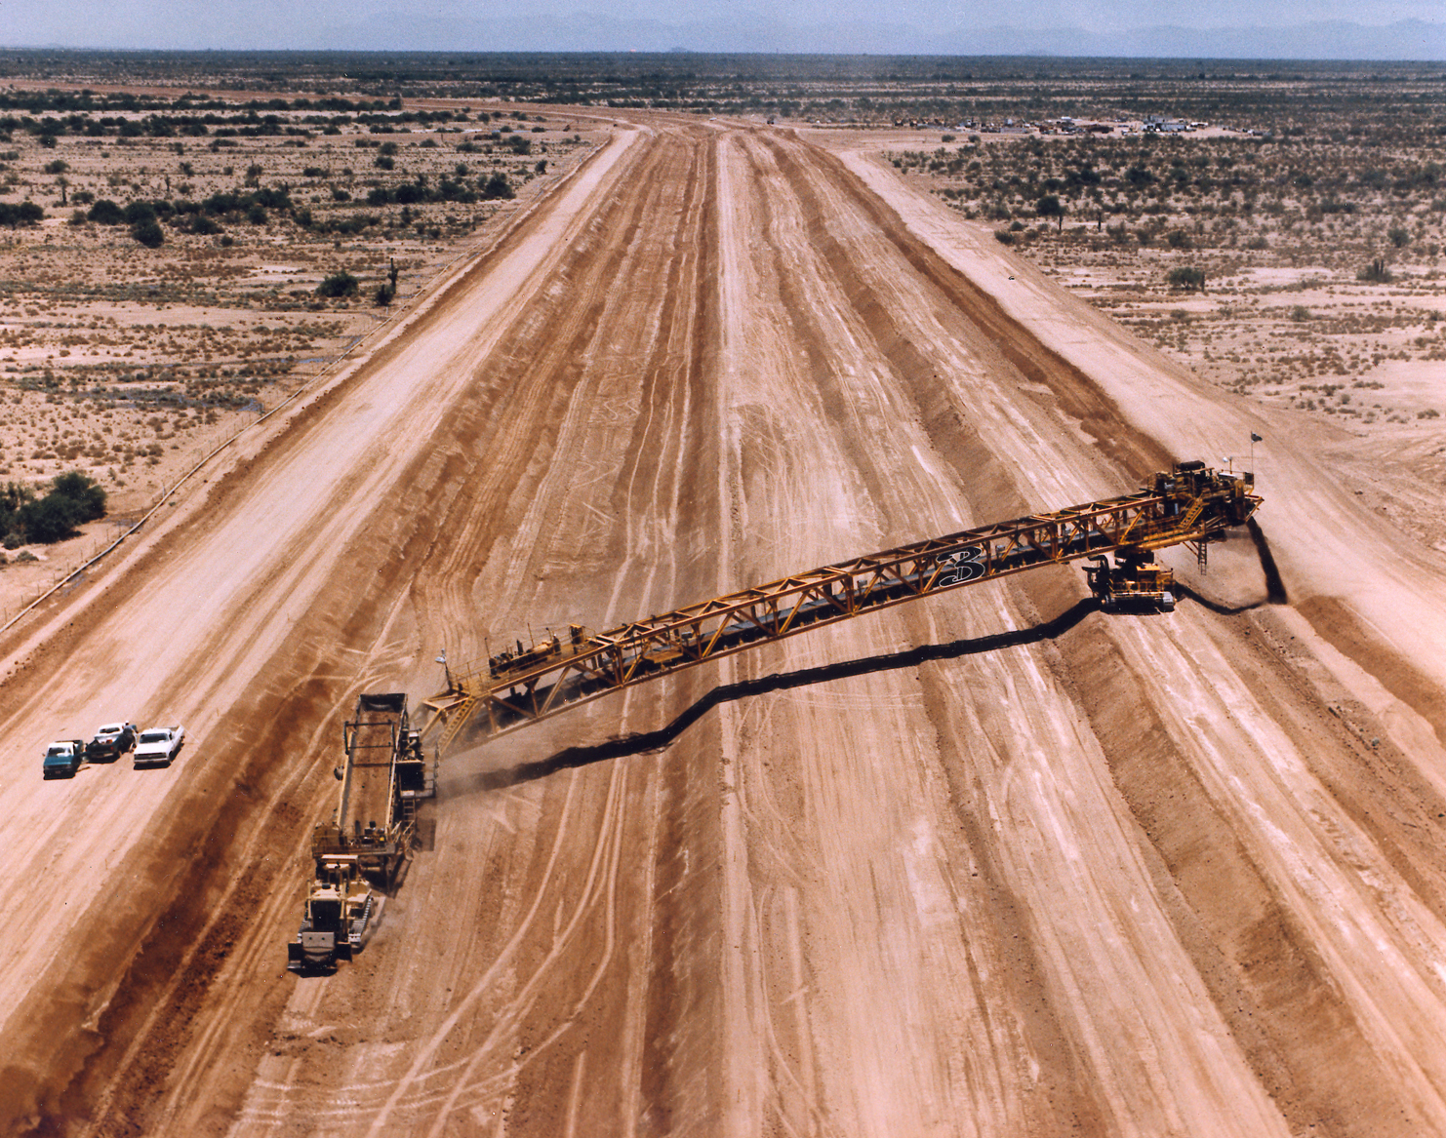
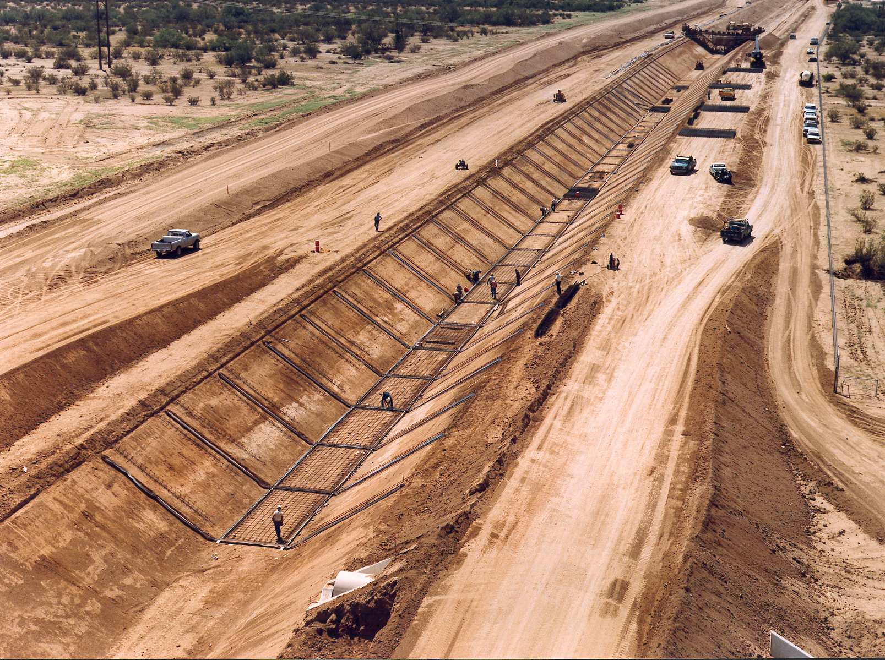
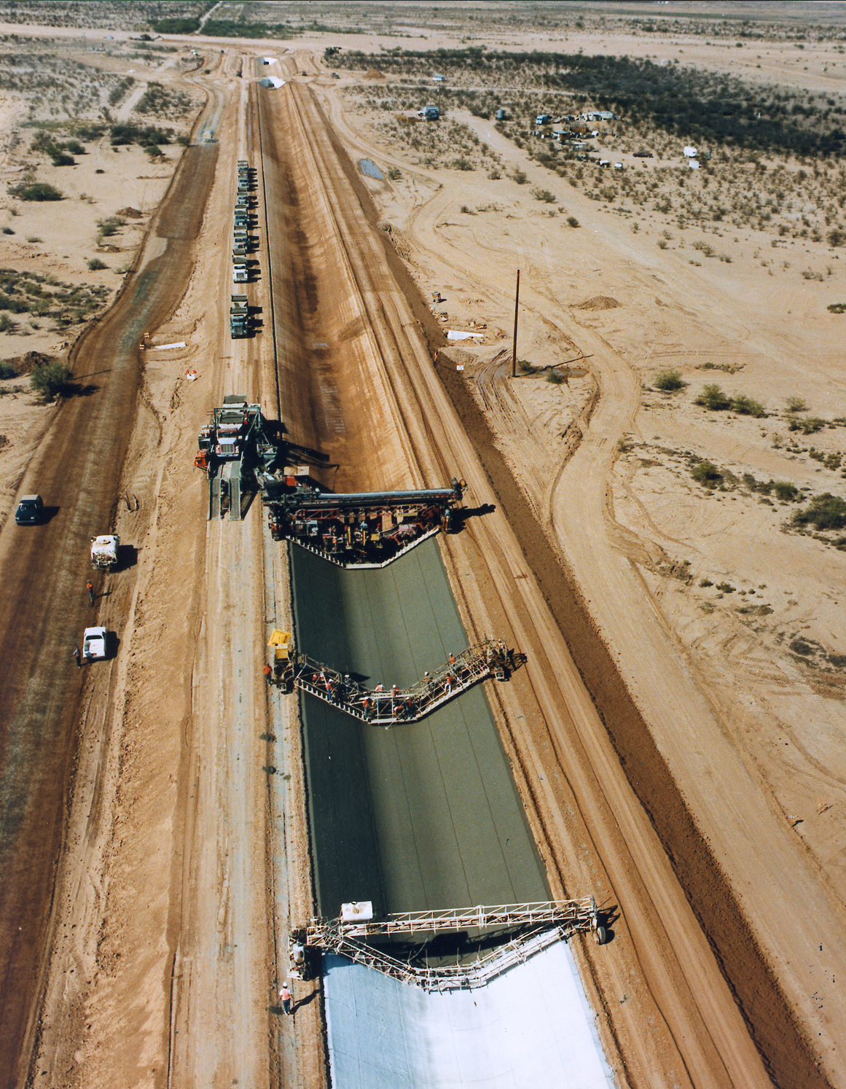
Aqueduct

Slide 10
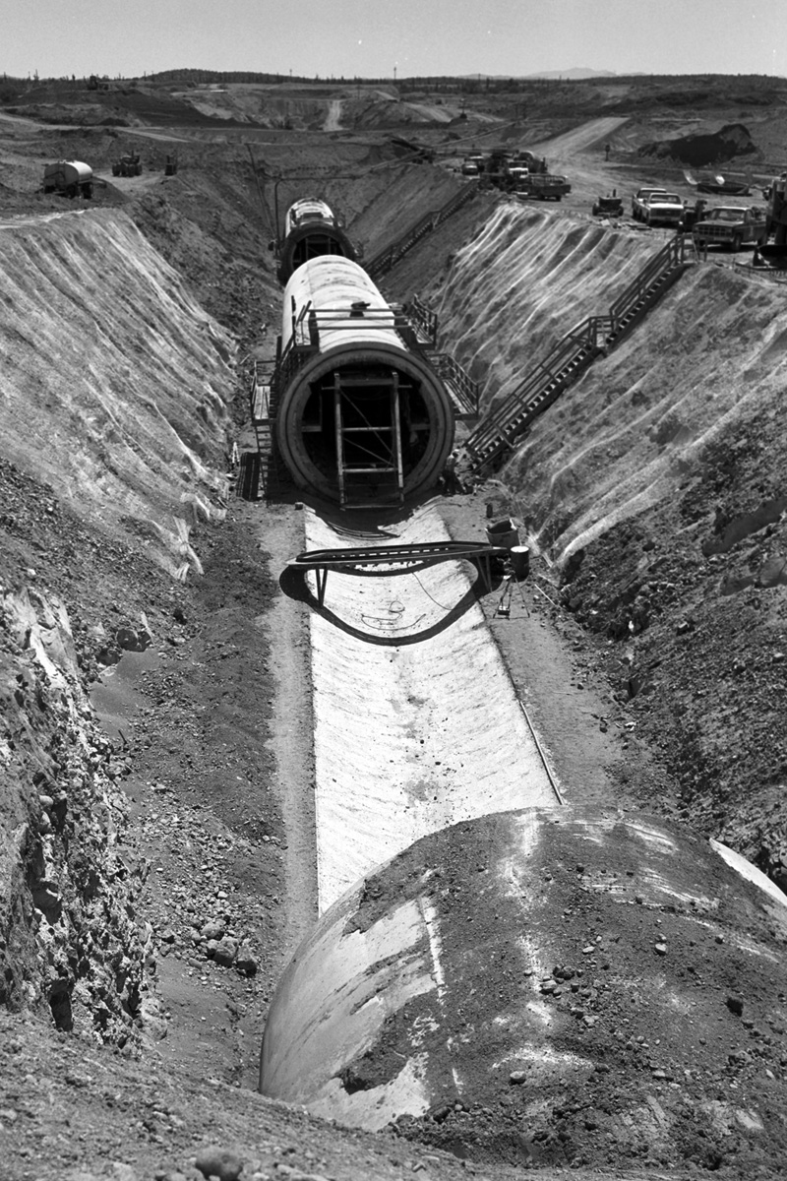
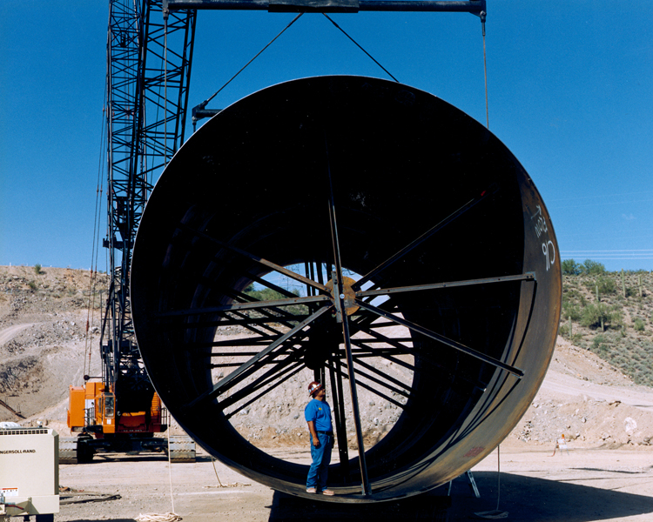
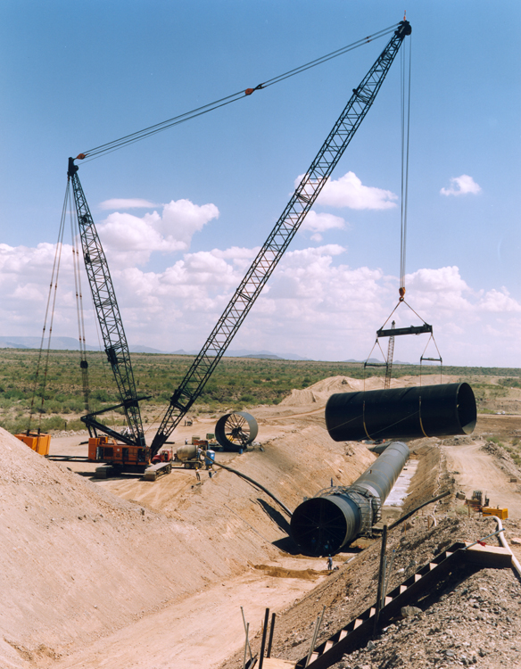
Siphons

Slide 11
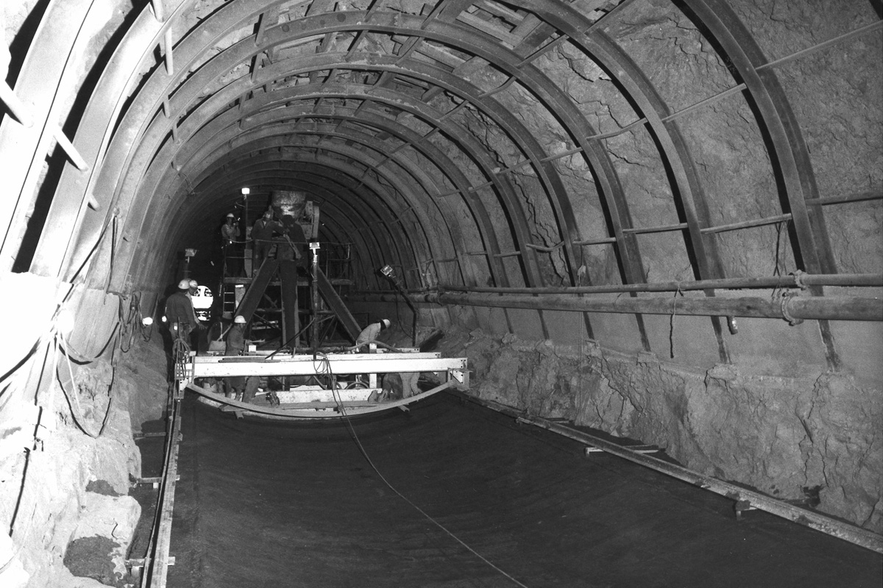
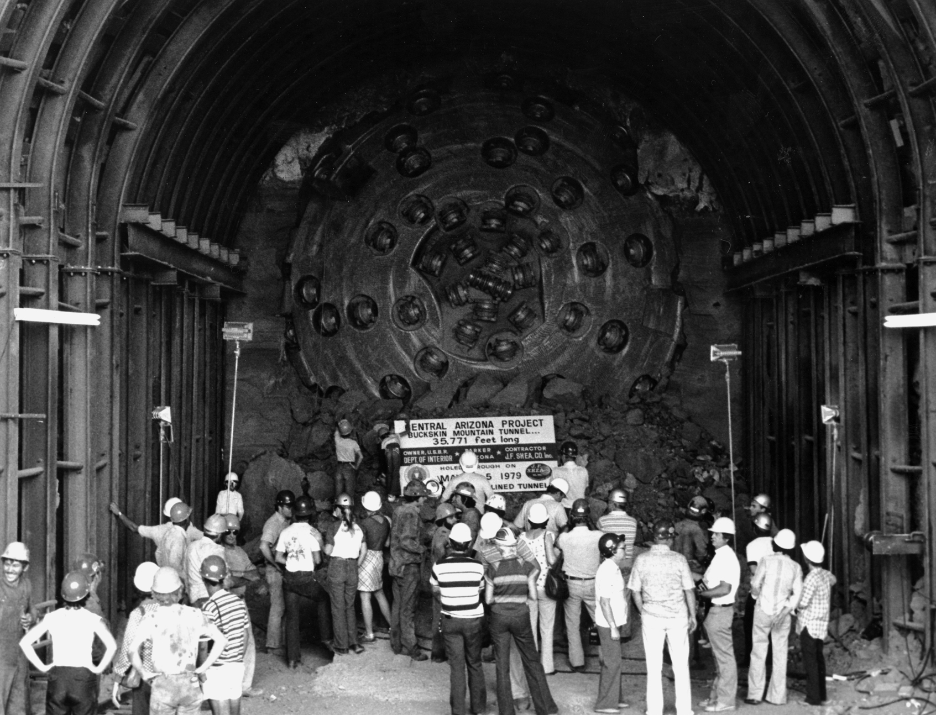
Tunnels

Slide 12
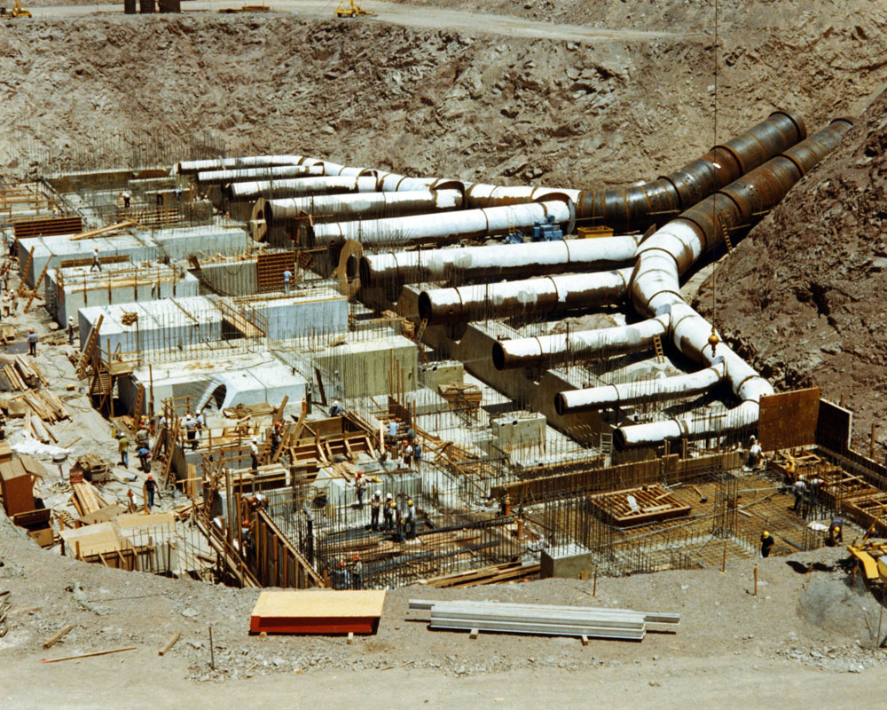
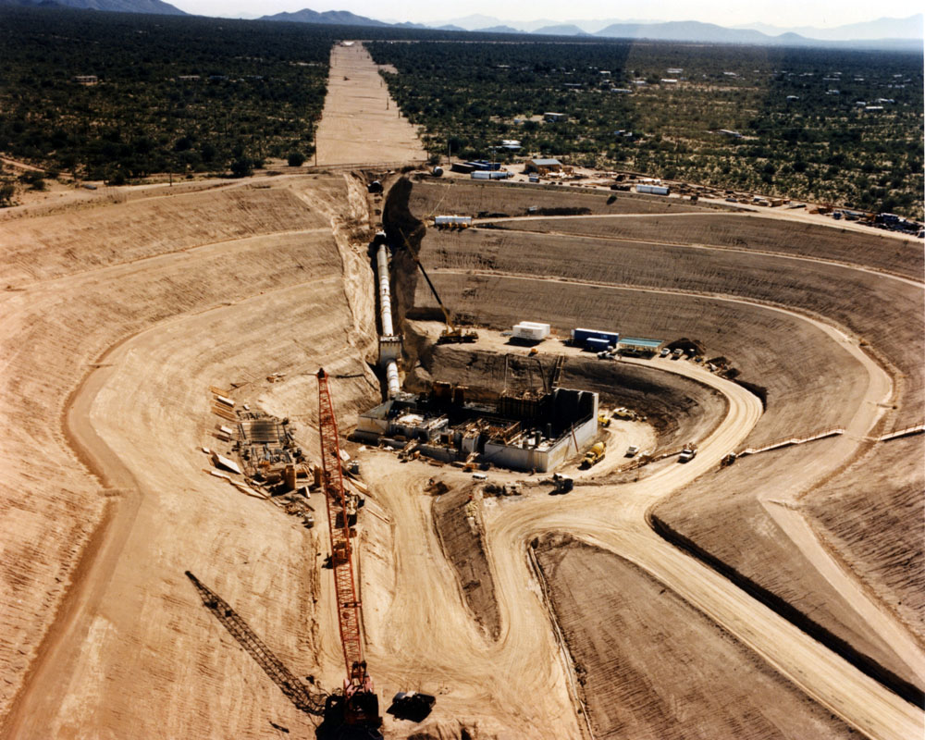
Pumping Plants

Slide 13
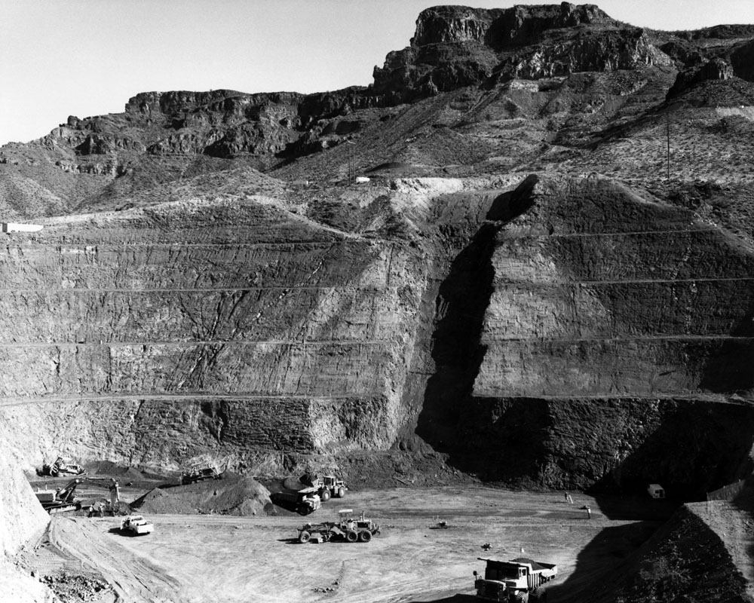
Diversion Works on Colorado River

Slide 14
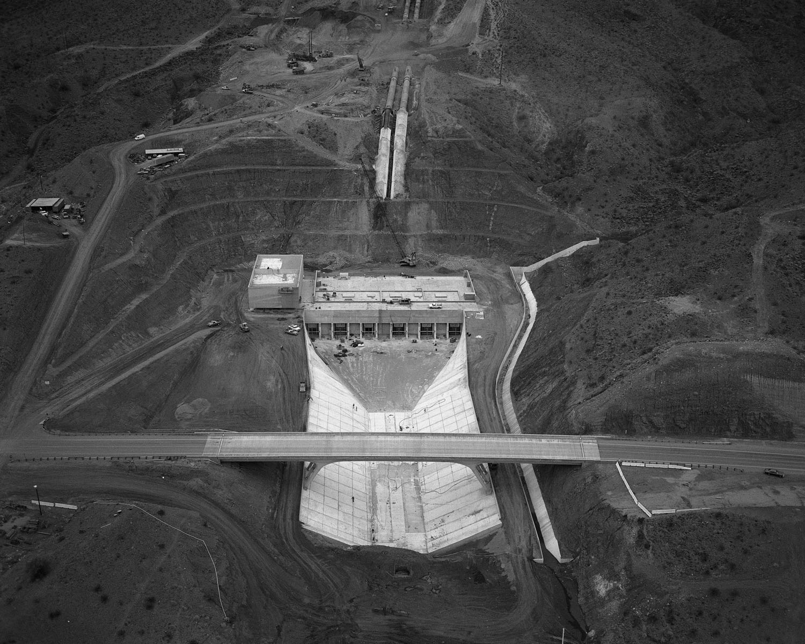
Diversion Works on Colorado River

Slide 15
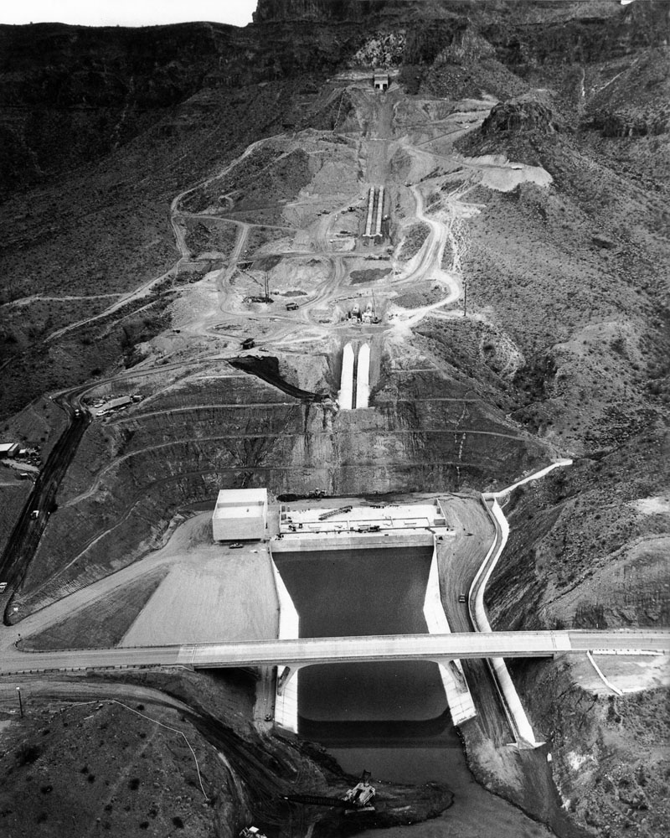
Diversion Works on Colorado River

Slide 16
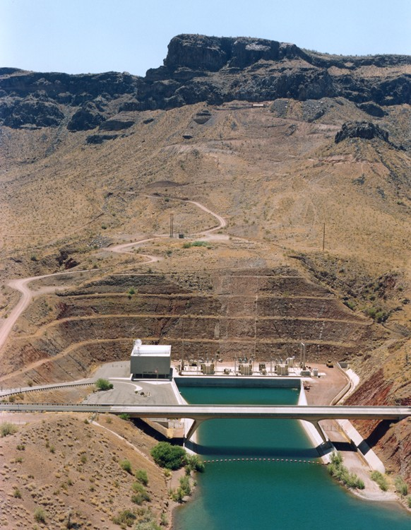
Diversion Works on Colorado River

Slide 17
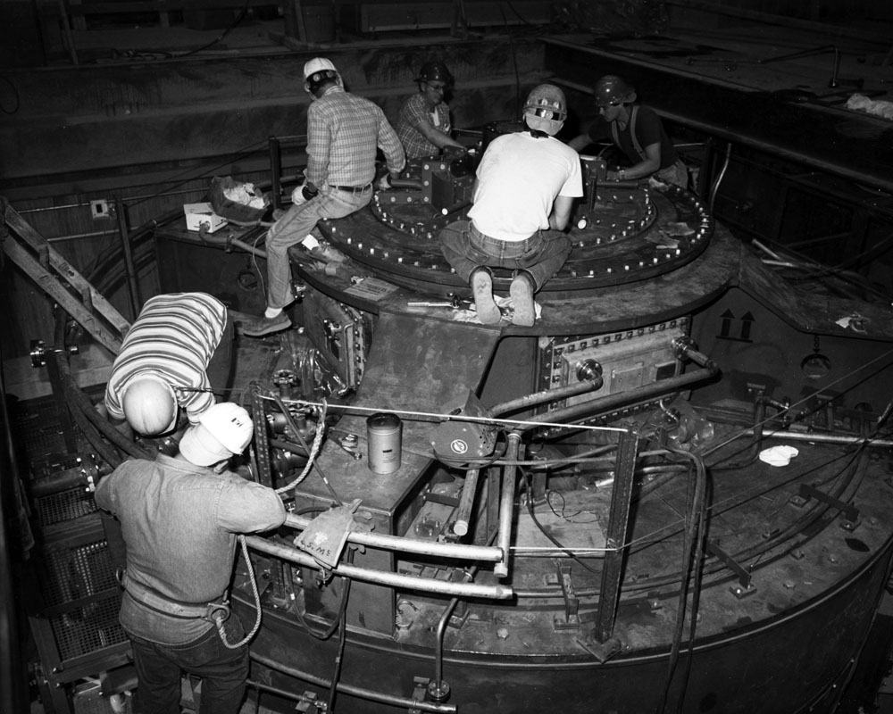
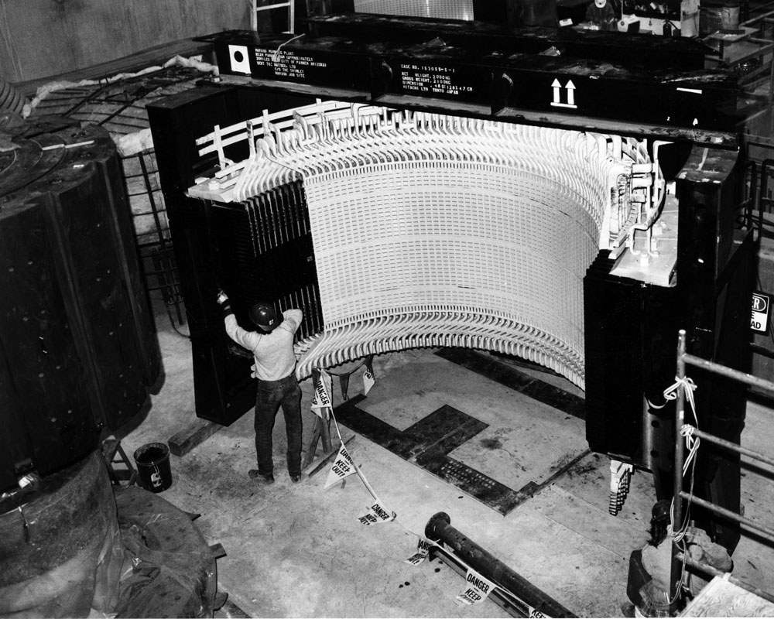
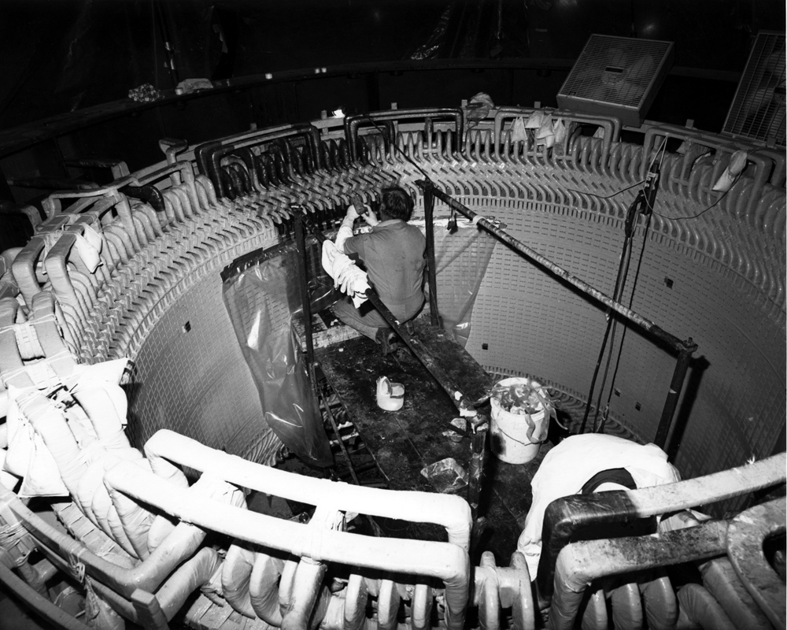
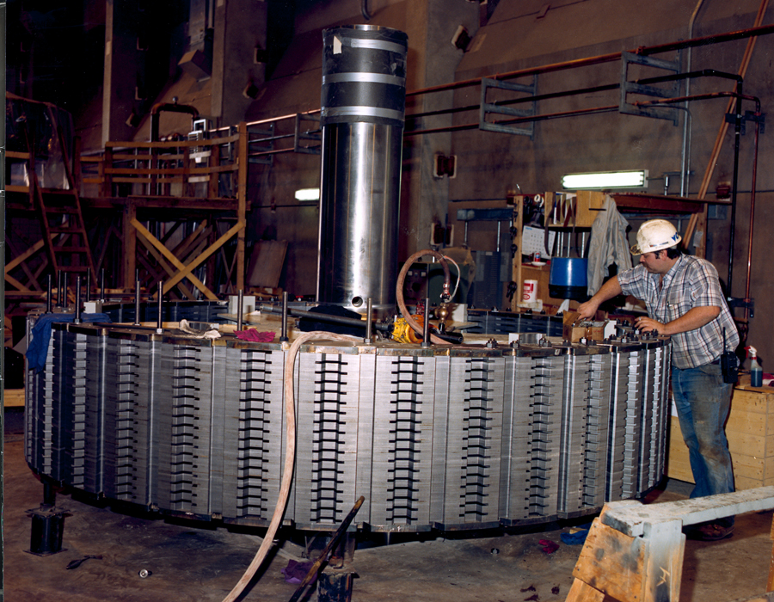
Motors

Slide 18

Control Center

Slide 19
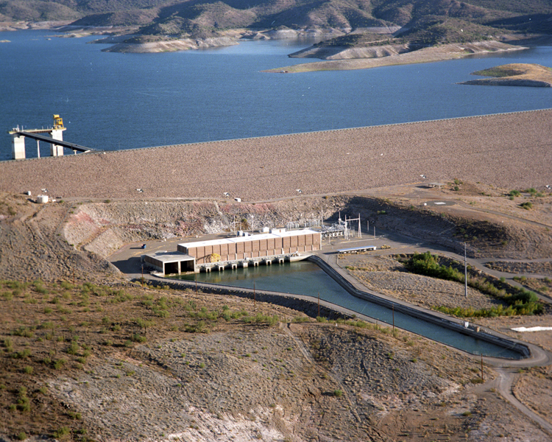
New Waddell Dam

Slide 20
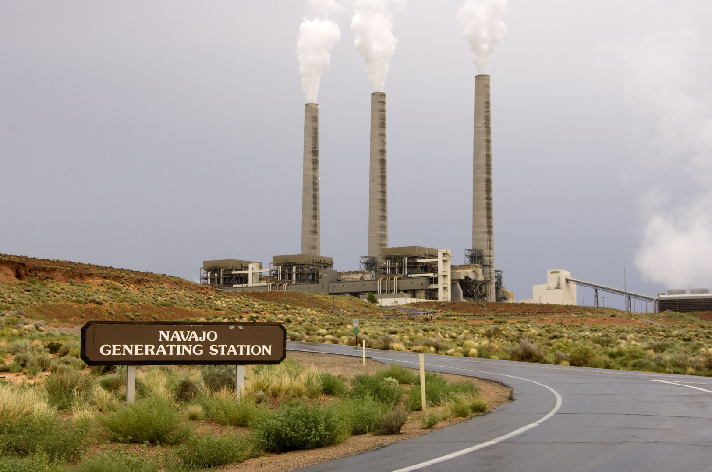
Navajo Generating Station

Slide 21
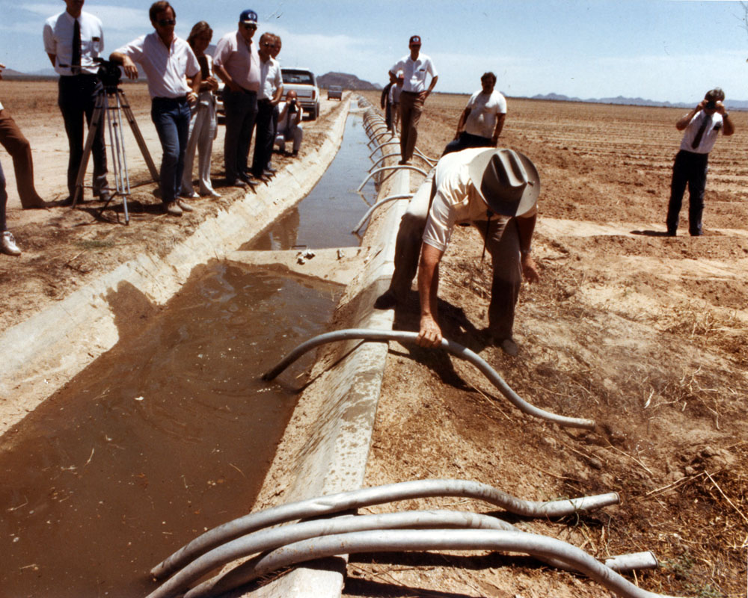
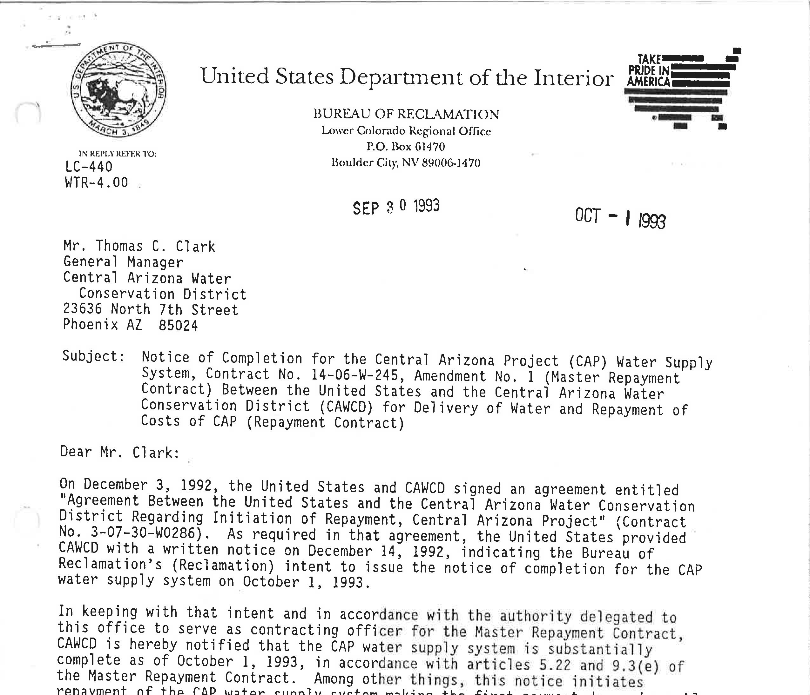
Construction Summary
Construction began in 1973
First CAP water delivered in 1985
CAP water supply system declared substantially complete in 1993
Total cost $4+ billion
Notes:
1916

Slide 22
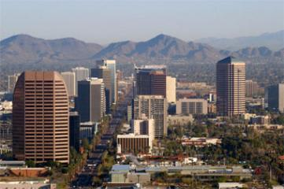
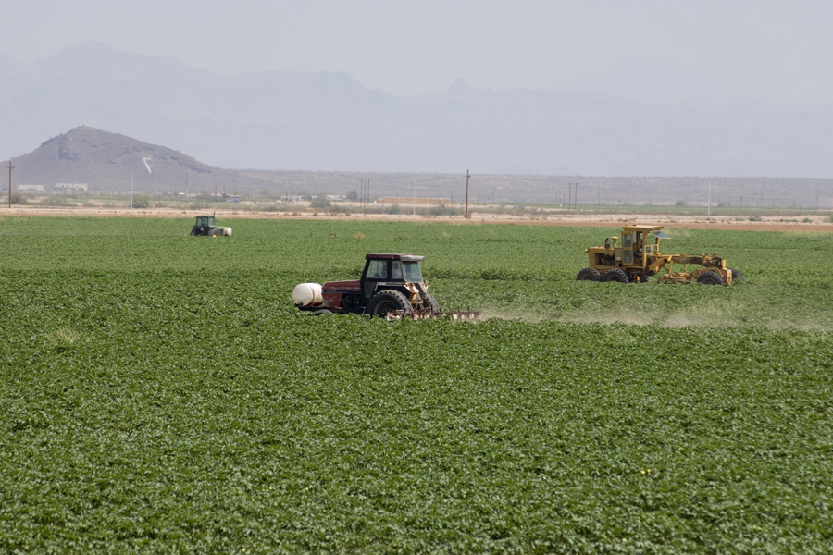
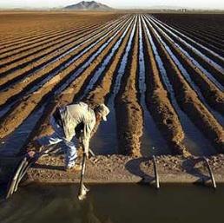
CAP Service Area
3 counties
23,790 square miles
< 8” annual rainfall
5 million people (80% of Arizona’s population)
  350,000 acres of irrigated agriculture
  11 Native American tribes

Slide 23
2013 CAP Deliveries
1.52 MAF

Slide 24
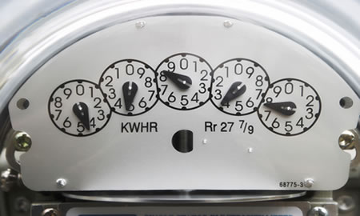

CAP Energy Use
CAP is largest power user in Arizona
2.8 million MWh needed to deliver 1.6 million acre-feet
Nearly 3000 feet of lift from Lake Havasu to terminus

Slide 25
CAP Elevation Profile

Slide 26
Energy Use by Pumping Plant

Slide 27
Need for Base Load Power
CAP system design
  Requires operation at constant volume
  Requires continuous operation (24/7) to deliver full water entitlements
CAP customers require deliveries 24/7
Repeated starts/stops increase cost and risk
  Pump/motor maintenance
  Potential canal damage due to constantly changing water levels
  Reduced system reliability

Slide 28
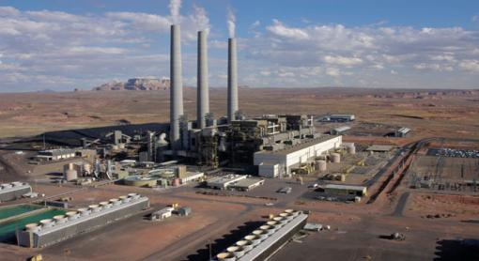
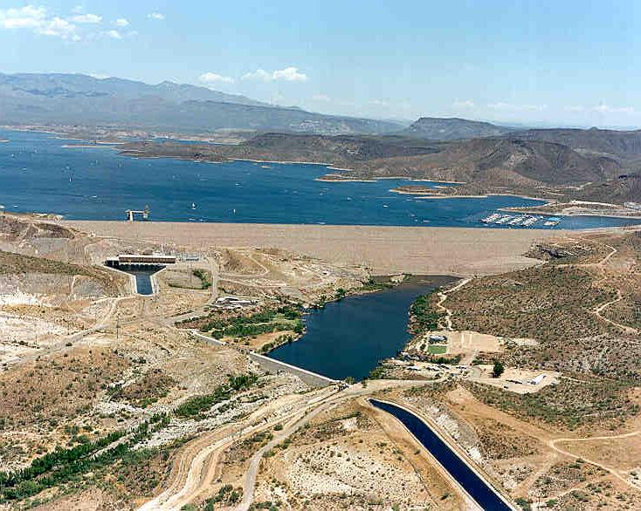
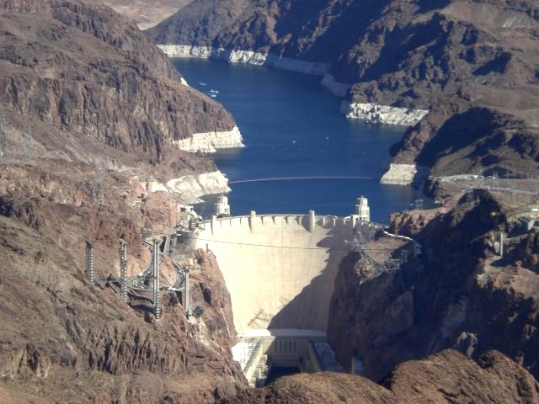
CAP Generation Resources
Navajo Generating Station
Hoover
New Waddell
Market

Slide 29
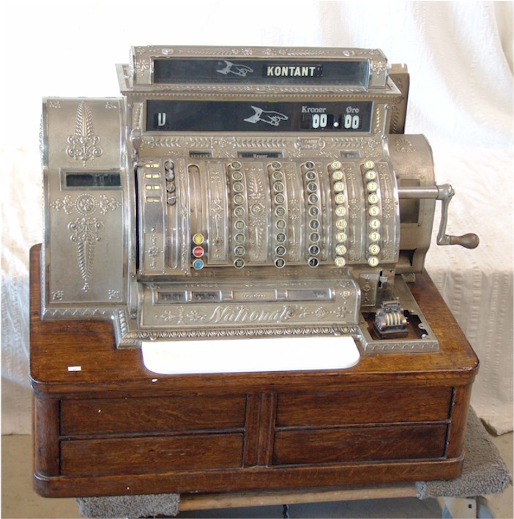
NGS Energy
CAP reserves NGS energy to meet pumping needs
Unreserved NGS energy is sold by Western Area Power Administration as Navajo Surplus
Net proceeds from sales of Navajo Surplus energy assist in CAP repayment

Slide 30
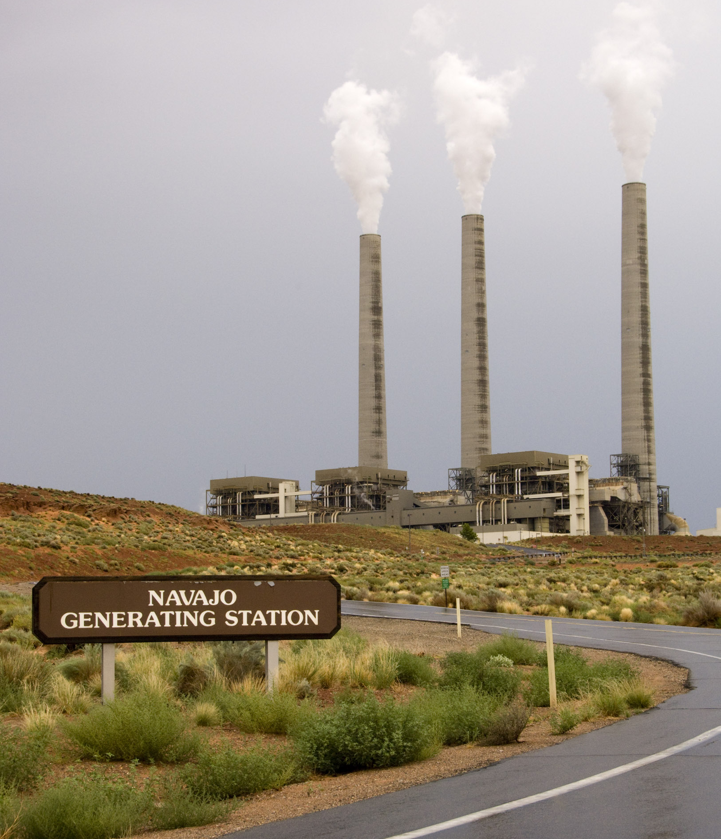
Issues Facing NGS
Navajo Nation land lease renewal
Coal contract renewal
Water contract renewal
Increasing operating costs
Environmental regulations
  Regional Haze Rule (BART)
  Mercury & Air Toxics Rule
  Ash Rule
  Carbon (?)

Slide 31
CAP Power Management
Lake Pleasant provides regulatory storage for CAP
Allows CAP to optimize pumping seasonally in response to energy market
  Pump from Colorado River primarily in winter
  Release from Lake Pleasant in summer

Slide 32
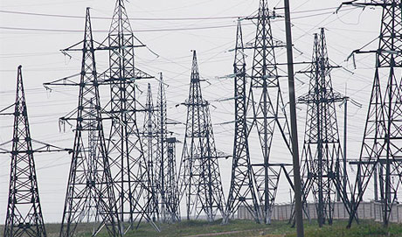
CAP Transmission Portfolio
Navajo Transmission
CAP Transmission
Contract rights
  Intertie
  Parker-Davis
Network Service
  APS
  SRP

Slide 33
Las Vegas
CRYSTAL
Page
NGS
McCULLOUGH
HOOVER
NAVAJO
DAVIS
MEAD
CAP
PARKER DAVIS
INTERTIE
APS
HAVASU
NEW
WADDELL
North Scottsdale
THUNDERSTONE
PARKER
RACEWAY
PINNACLE PEAK
HARCUVAR
HASSAYAMPA
Morgan
Parker
SALT GILA
BOUSE
Sun Valley
LITTLE
HARQUAHALA
WESTWING
ROGERS
SPOOK HILL
LIBERTY
Mesa
PALO VERDE
Buckeye
Sun City
CAP Transmission Map
COOLIDGE
ED-2
BRADY
ED-4
PICACHO
ED-5
RED ROCK
SAGUARO
TWIN PEAKS
RATTLESNAKE TAP
SANDARIO
TUCSON
BRAWLEY
Avra Valley
Tucson
SNYDER HILL / BLACK MOUNTAIN
SAN XAVIER
DEL BAC

Slide 34
Questions?

